Slide 1
Welcome!
We’ll start a few
minutes after 10am
US Central Time

Slide 2
Consciousness
Abdul Alkalimat
IFA: Intro for all
Community Lecture #5
September 23, 2023

Slide 3
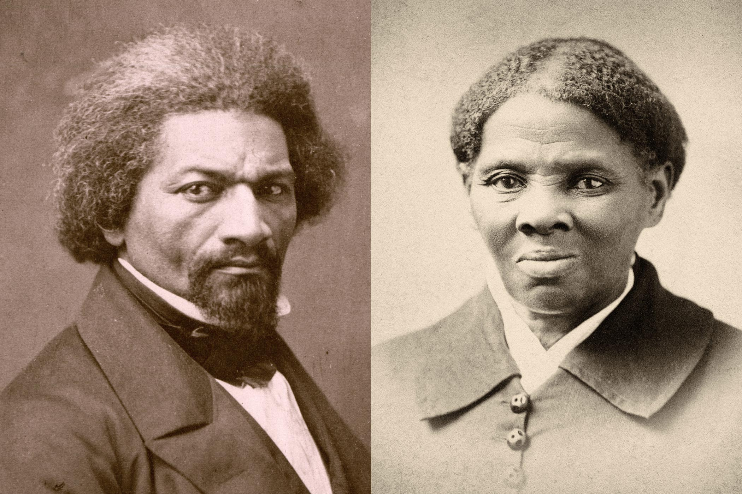
Outline
1. What is consciousness?
2. Objective vs subjective
3. Five ideological traditions
4. Three Great Debates
5. Agency

Slide 4
Epistemology
Perception ←→ Cognition
Sankofa

Slide 6
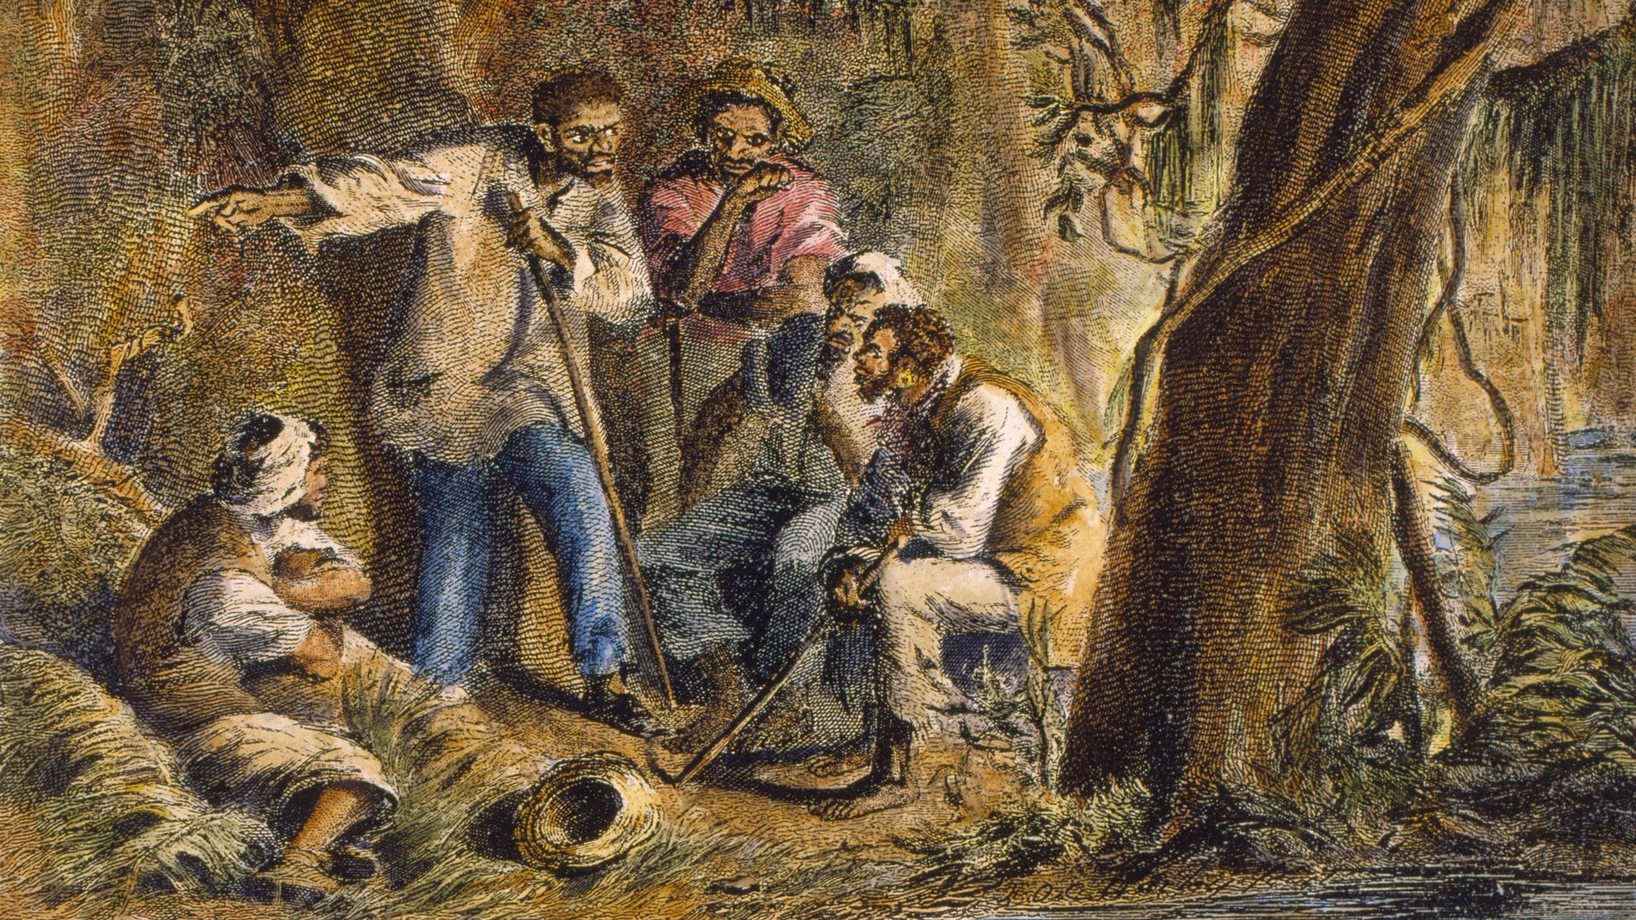
“Freedom is the recognition of necessity.”
— Friedrick Engels

Slide 7
The objectivity of Black history: modes of social cohesion, modes of social disruption
Africa
Slave trade
Slavery
Emancipation
Rural tenancy
Great migrations
Urban industry
Structural crisis
Information society

Slide 8
The Black Experience
Objective
Color (Biology)
Class (Political economy)
Culture (Community)
Gender (Community)
Subjective
Consciousness (Psychology, Philosophy)

Slide 9
Many Black people wonder what would happen if we could flip the script, and reverse roles with white people.

Slide 10
Class consciousness
Capitalist class Form the mainstream Middle class Perform the mainstream Working class Reform the mainstream Anti-class Transform the mainstream
But what about false
class consciousness?

Slide 11
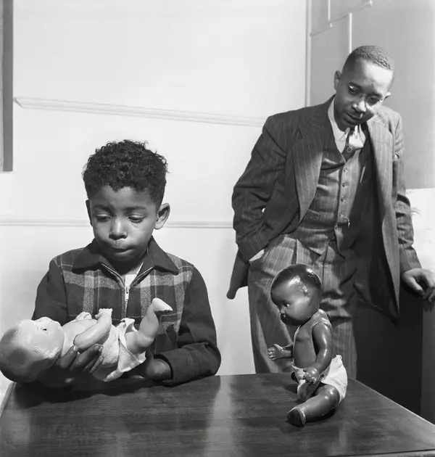
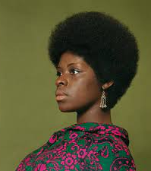
Self affirmation or self negation
Black culture versus racist culture

Slide 12
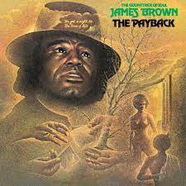
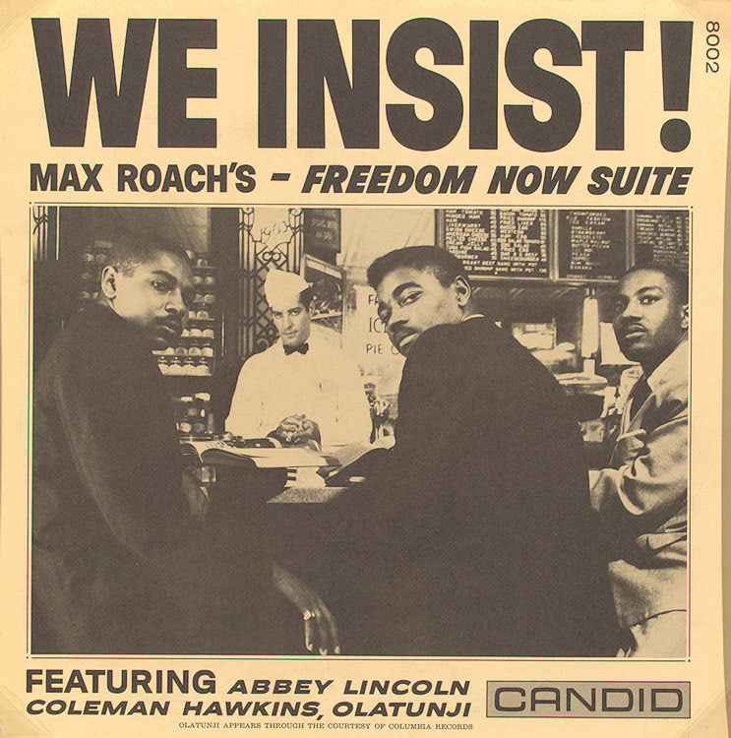
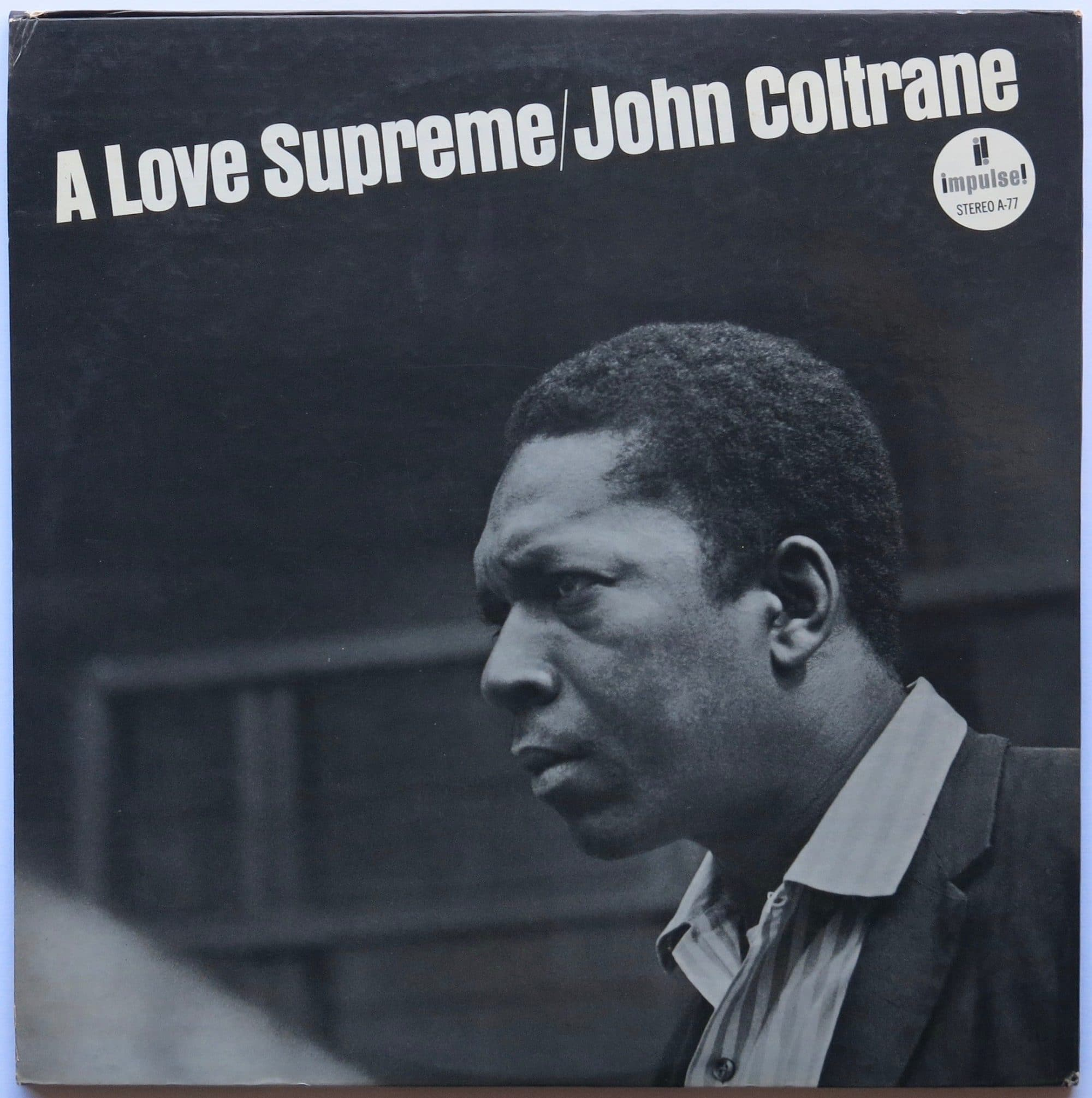
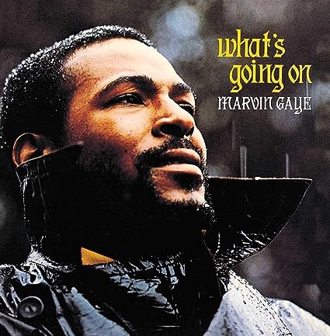
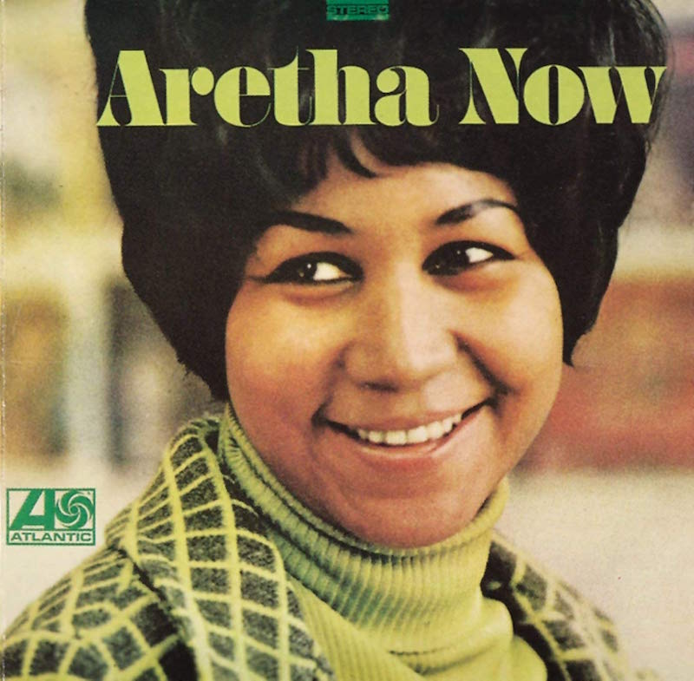

Slide 13
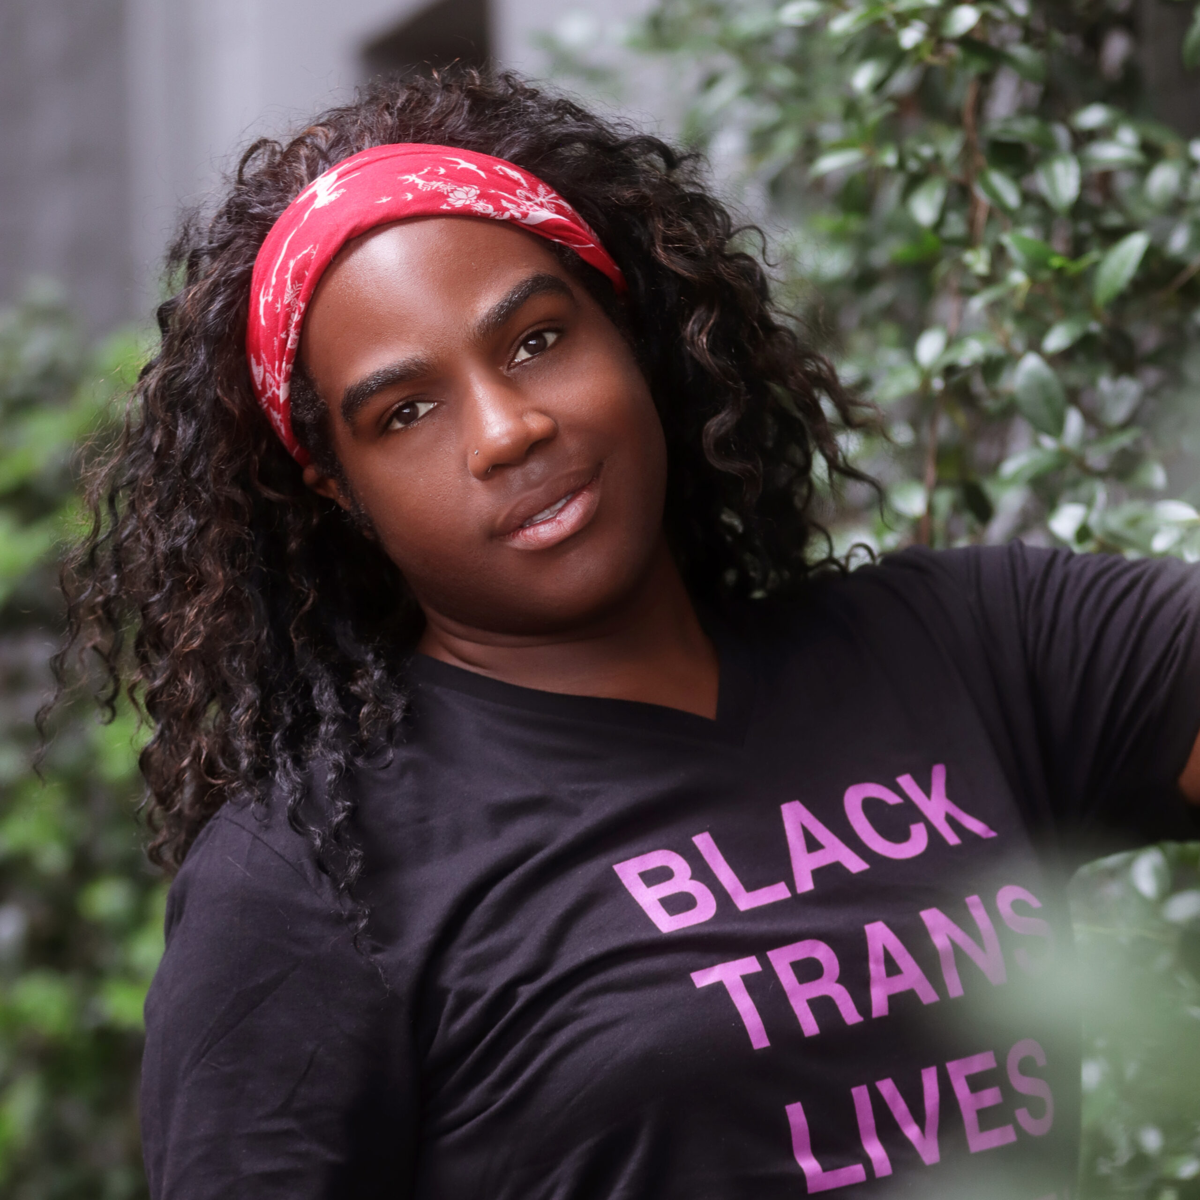
All genders
are beautiful

Slide 14
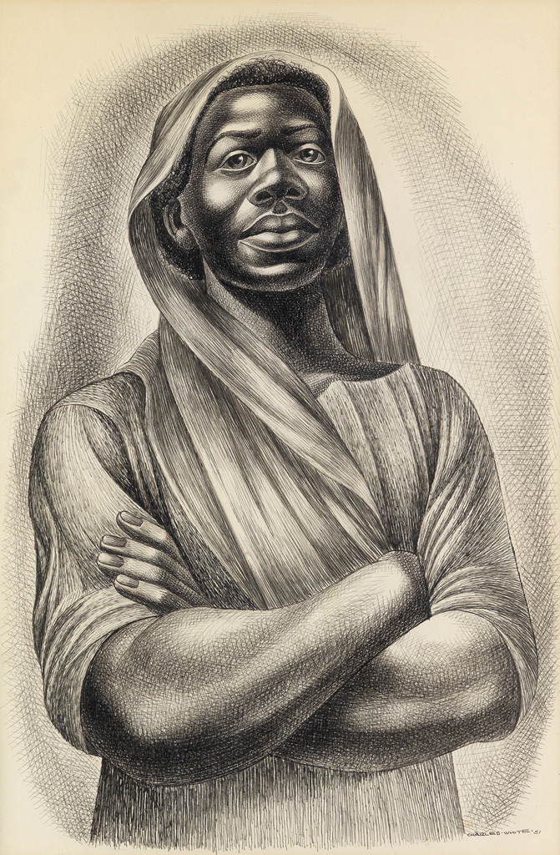
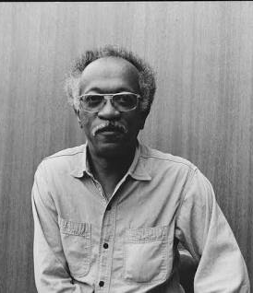
Main Black ideologies
Black liberation theology
Pan-Africanism
Nationalism
Womanism
Socialism
Charles White

Slide 15
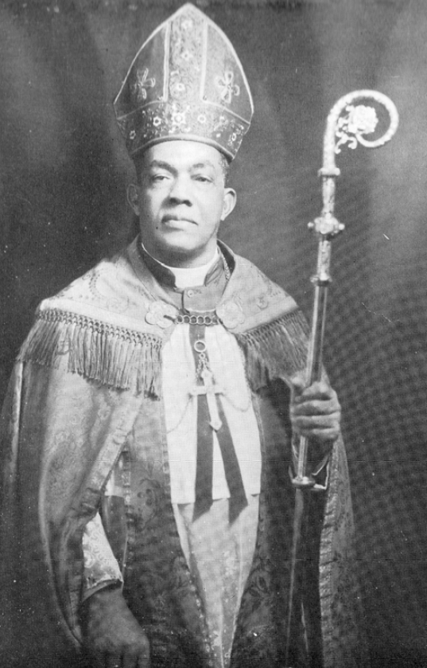
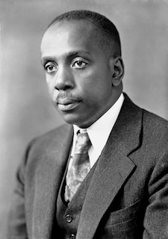
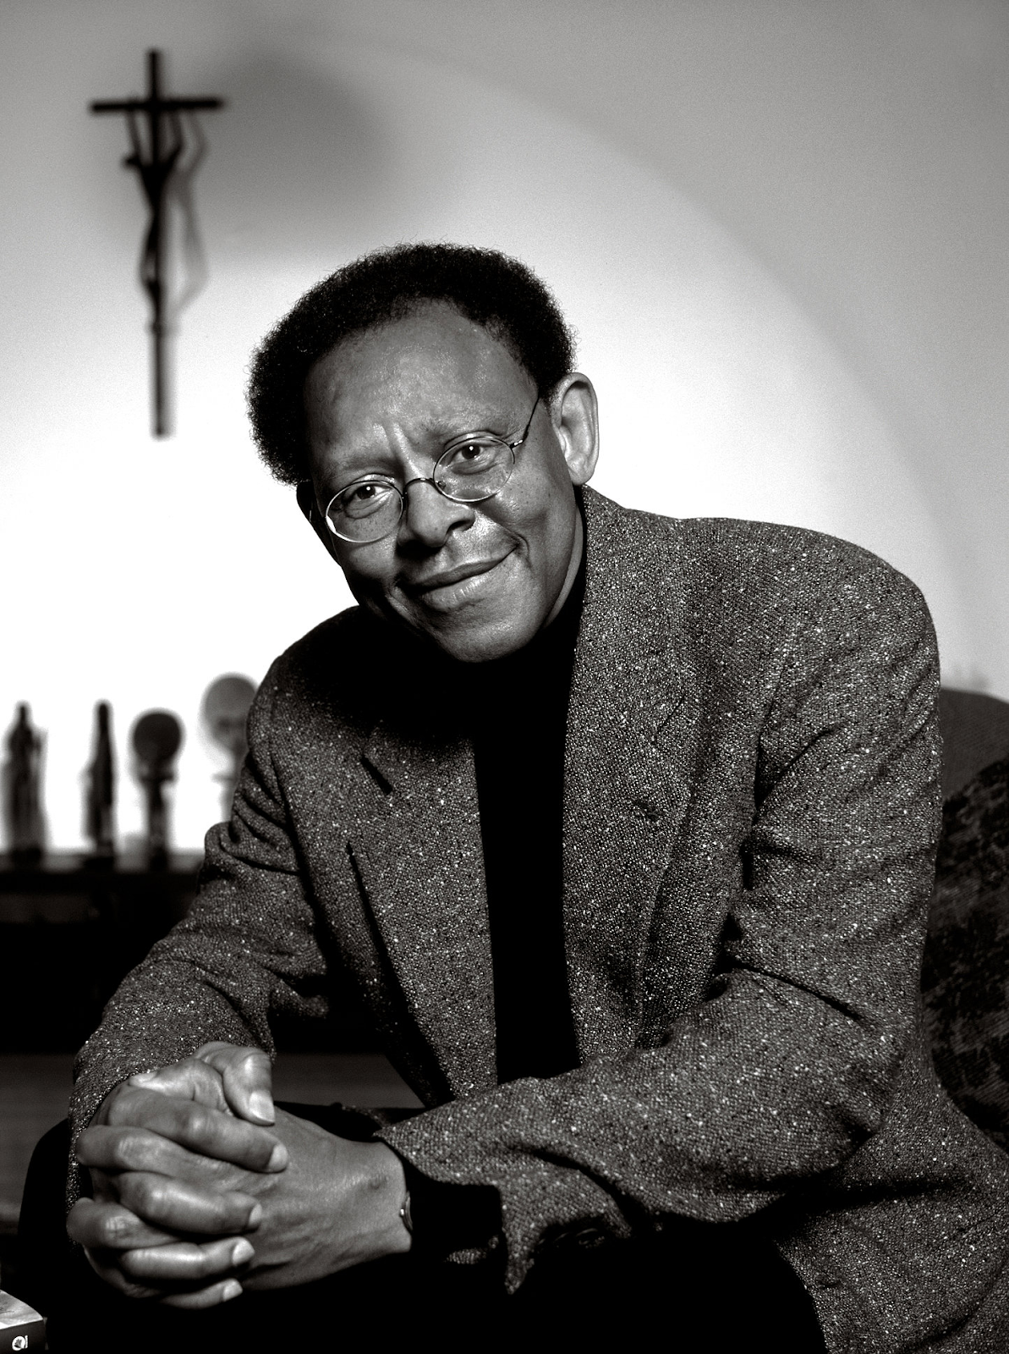
Black Liberation Theology A theology that sees God as concerned
with the salvation of the poor and the weak.
George McGuire
Howard Thurman
James Cone

Slide 16
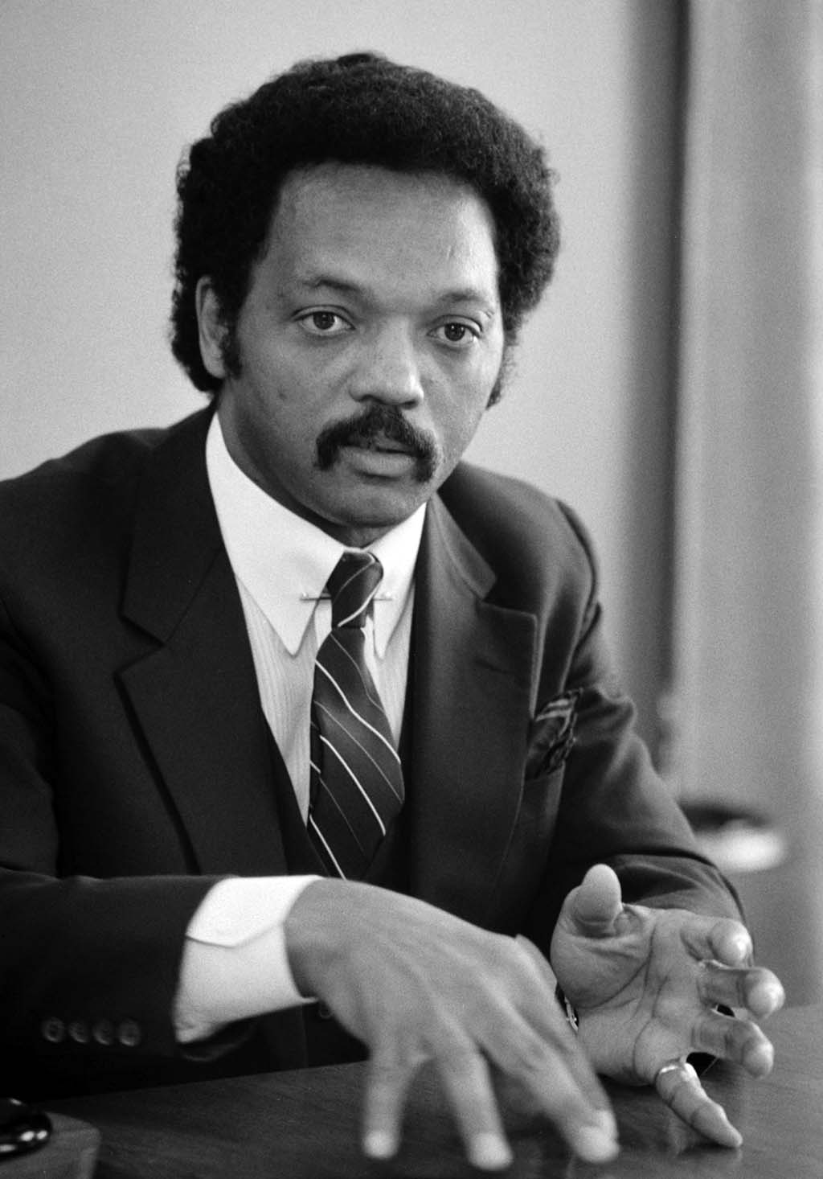
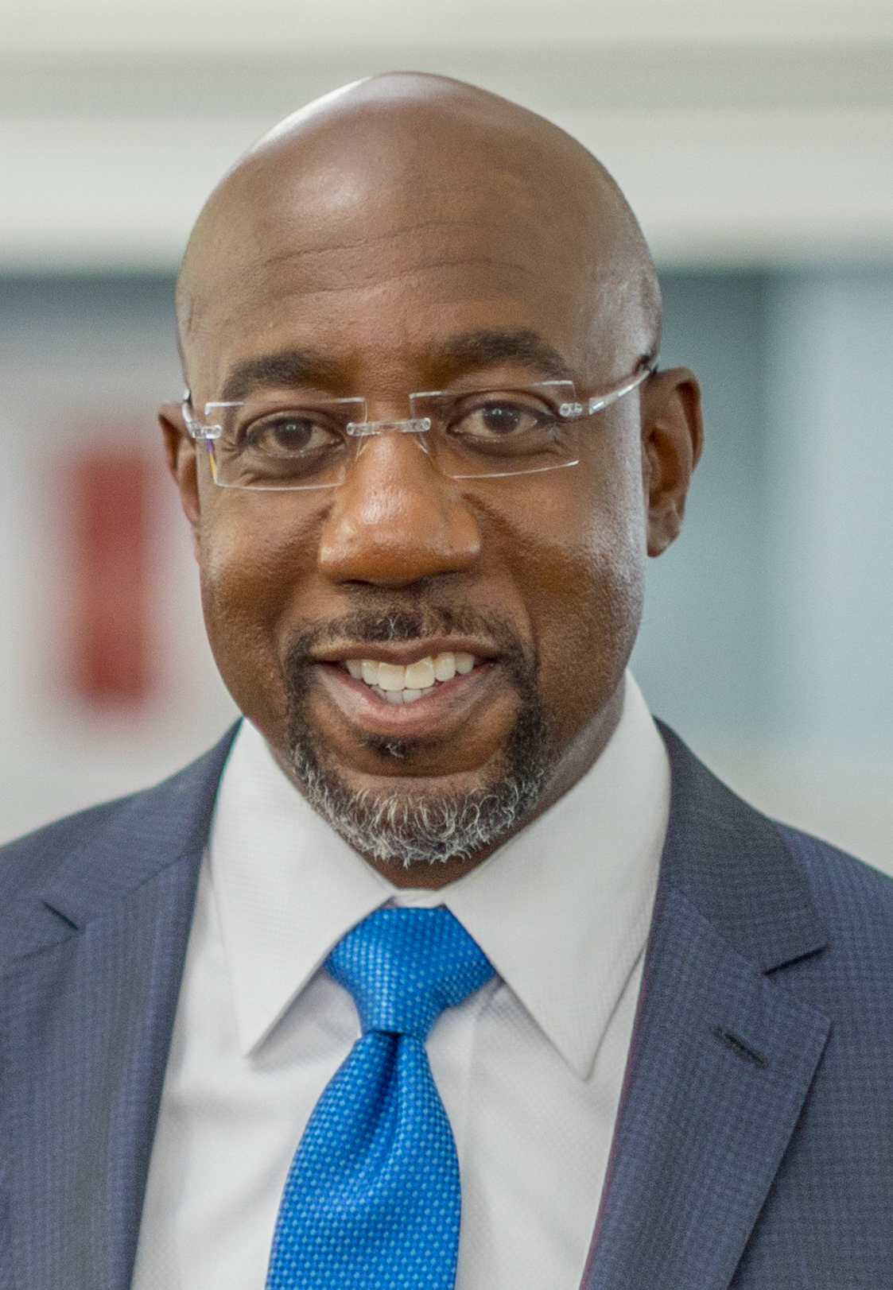
The Black Church
Transforming social justice with morality
“Learn to do good; seek justice, correct oppression; bring justice
to the fatherless, and please the widow's cause,” (Isaiah 1:17).
Jesse Jackson
Adam Clayton Powell Jr.
Raphael Warnock

Slide 17
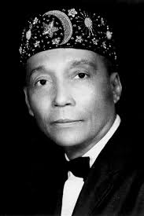
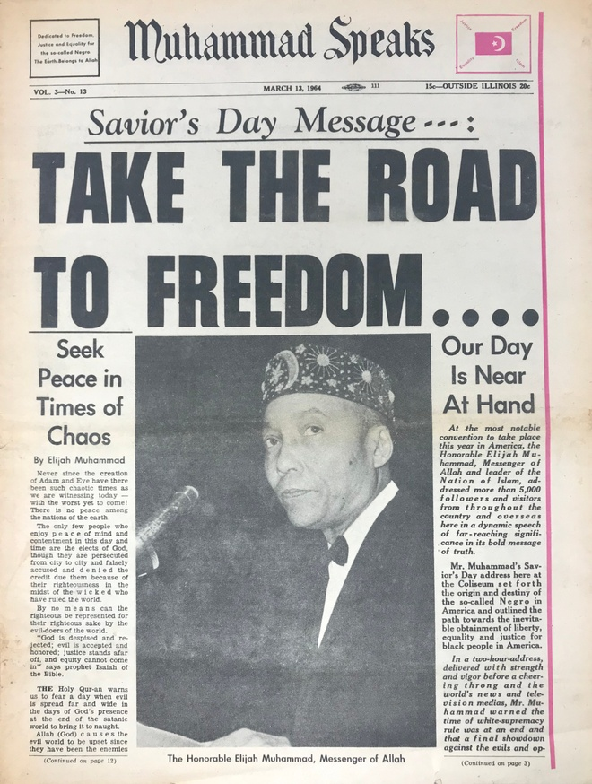
The Nation of Islam

Slide 18
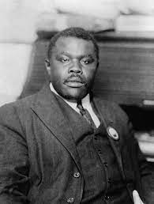
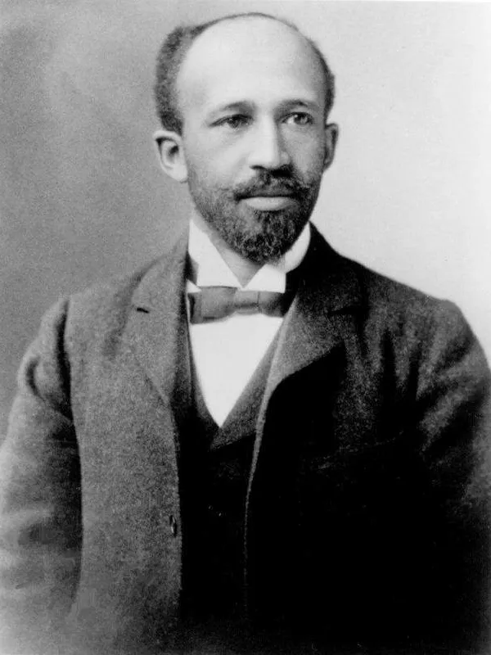
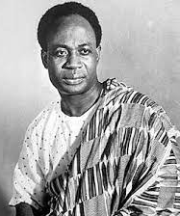
Pan Africanism
Marcus Garvey
W.E.B. DuBois
Kwame Nkrumah
“We are saying that we identify with the African people of the African continent. We are saying that we are an African people. And when we make this identification, we have no illusions about the fact that this is a very revolutionary initiative; it is a rejection of every other form of identification which the white society has asked us to accept.” Walter Rodney

Slide 19
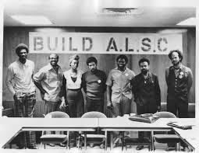
African Liberation Support Committee Executive Committee

Slide 20
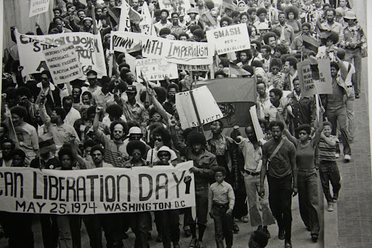
African Liberation Support Committee Demonstration

Slide 21
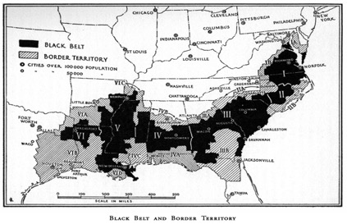
A nation is a historically constituted, stable community of people, formed on the basis of a common language, territory, economic life, and psychological make-up manifested in a common culture

Slide 22
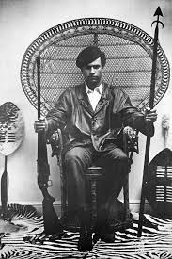
Huey Newton
Stokely Carmichael – Kwame Ture

Slide 23
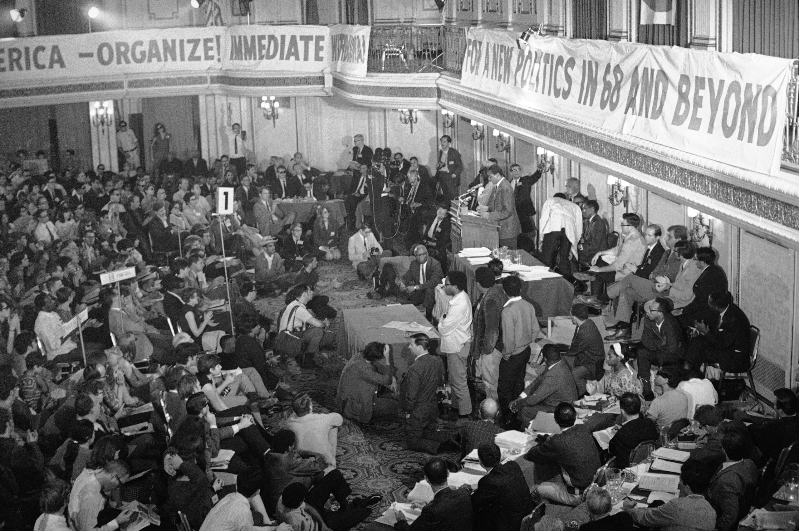
July 20, 1967: The first national Black Power conference in Newark, NJ

Slide 24
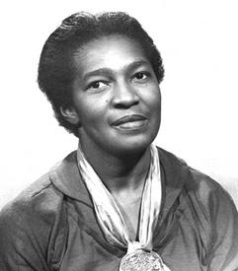
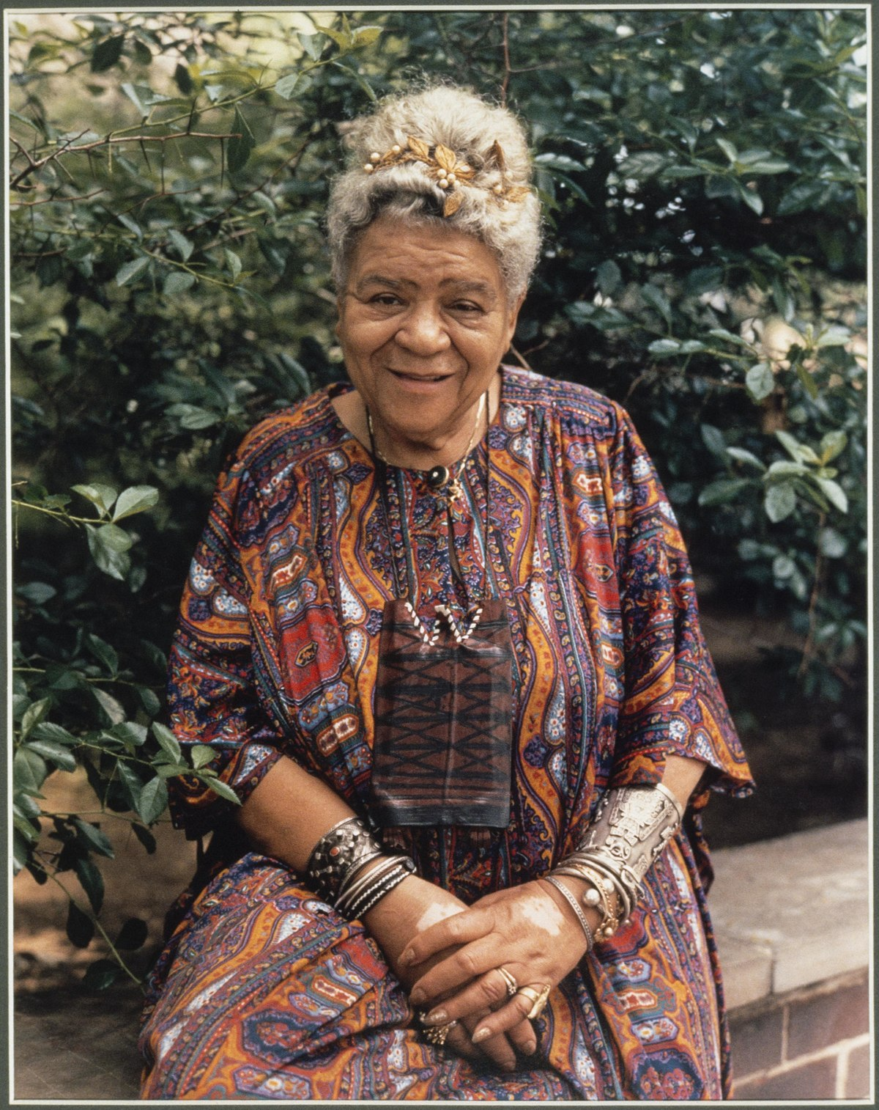
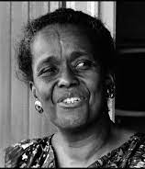
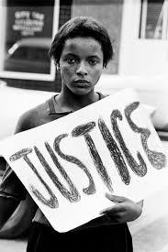
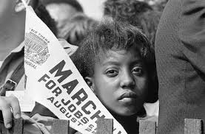

Slide 25
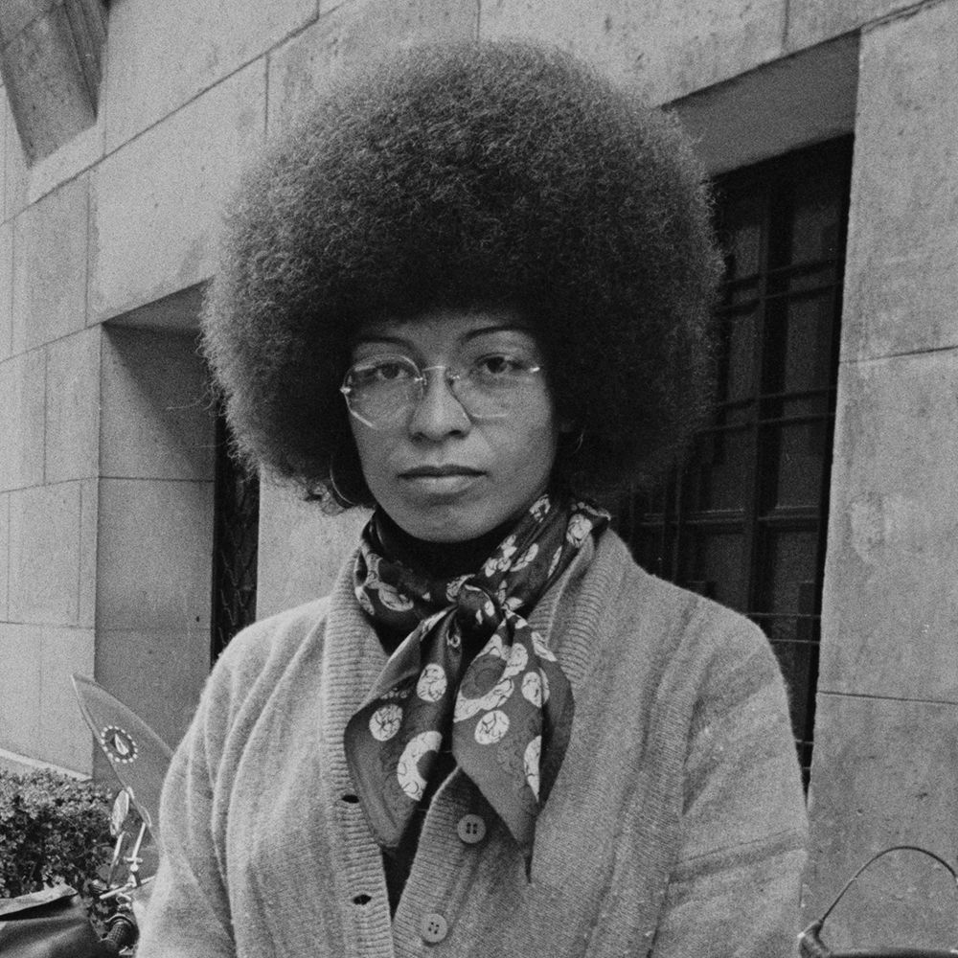
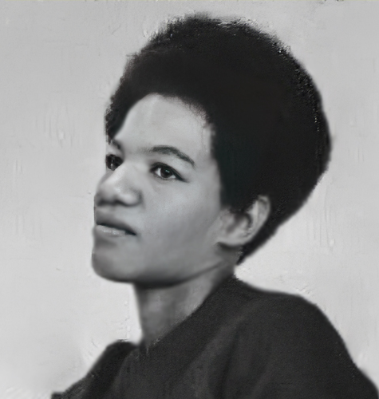
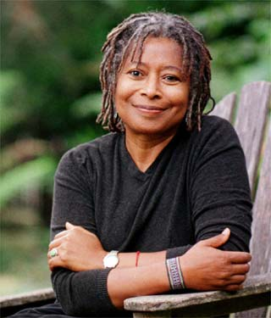
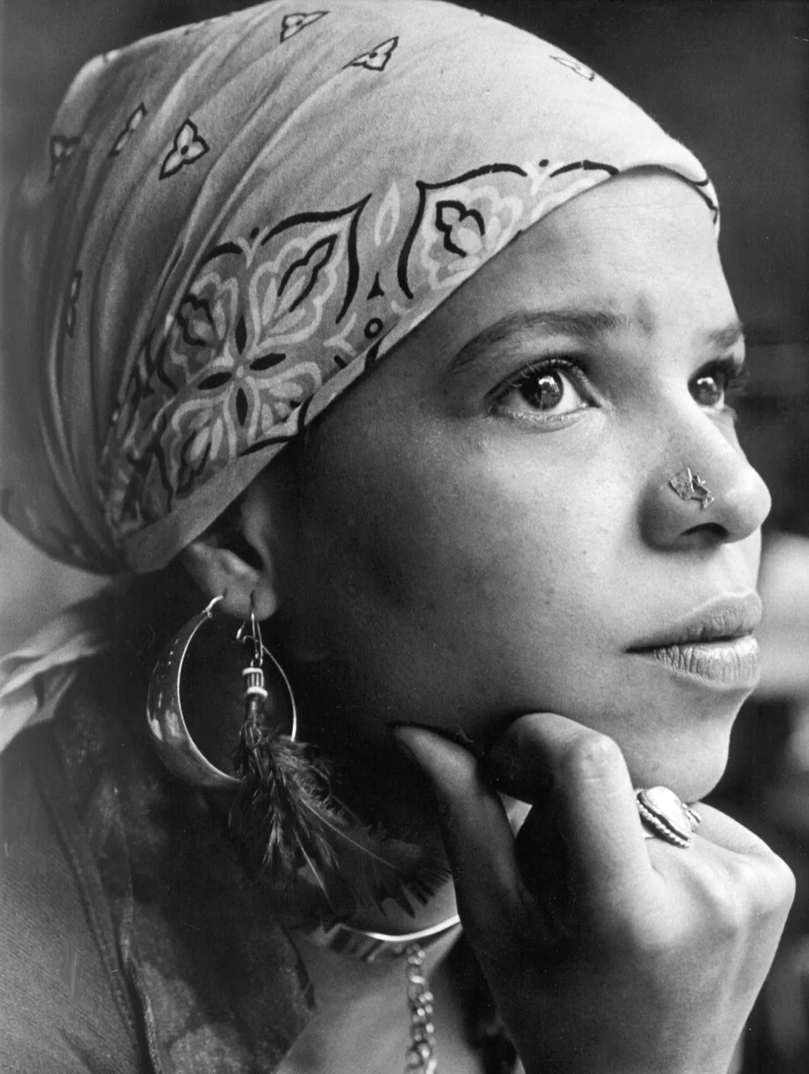
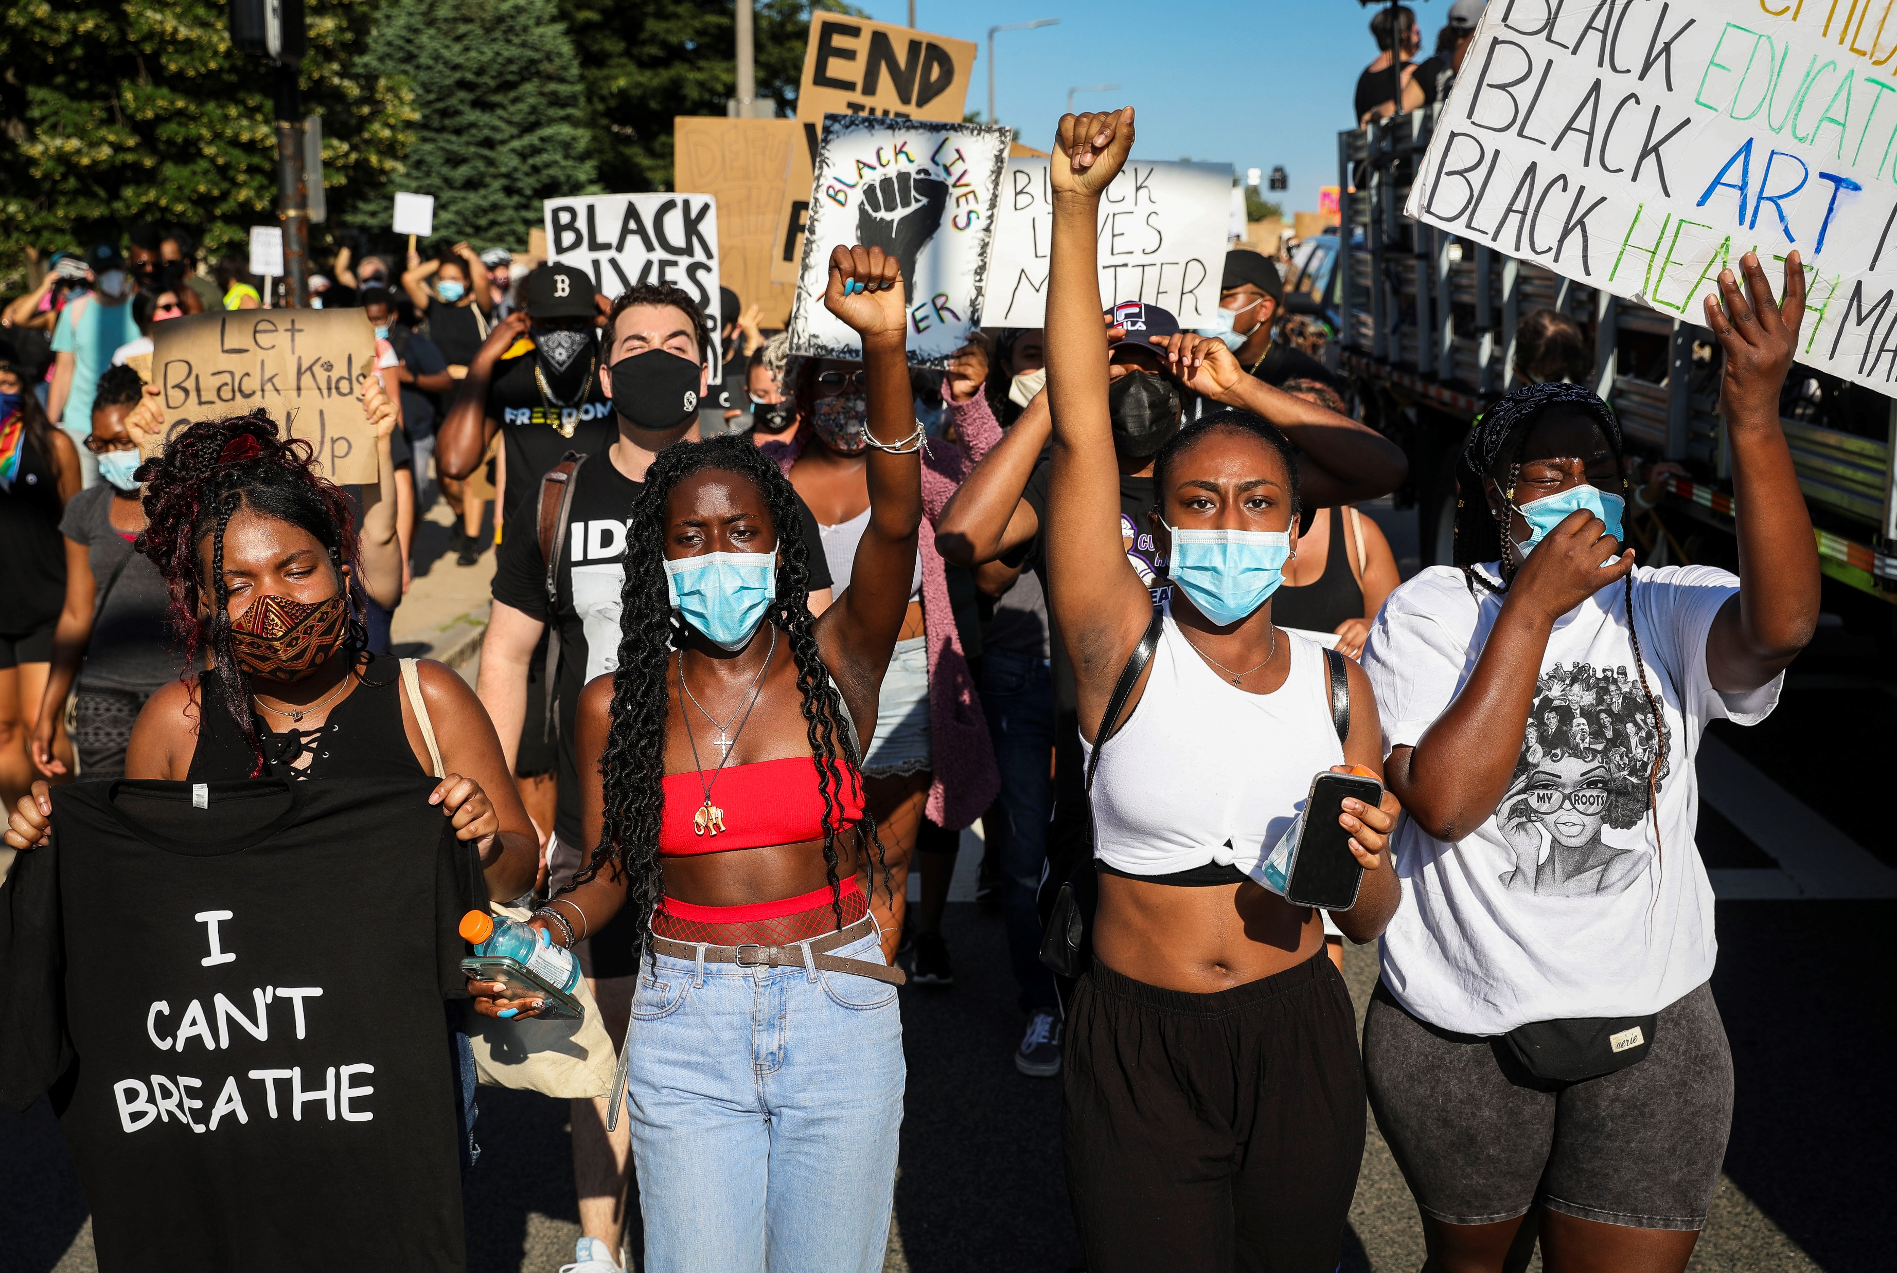

Slide 26
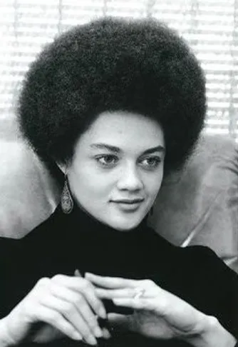
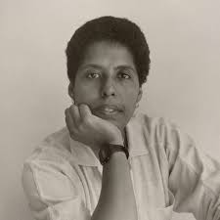
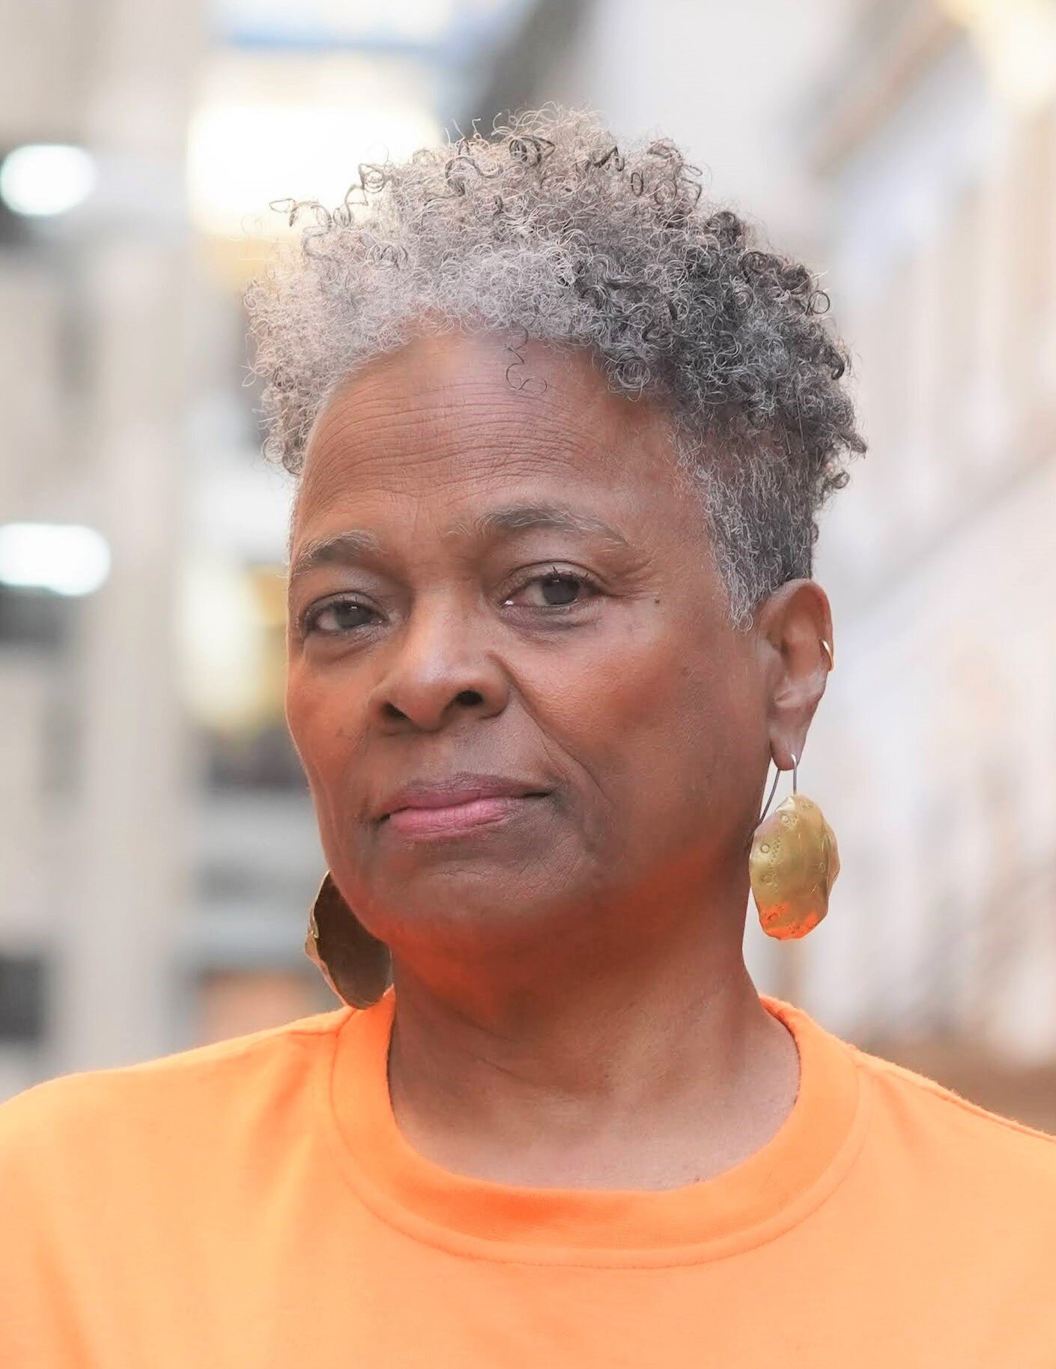
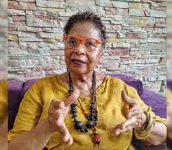
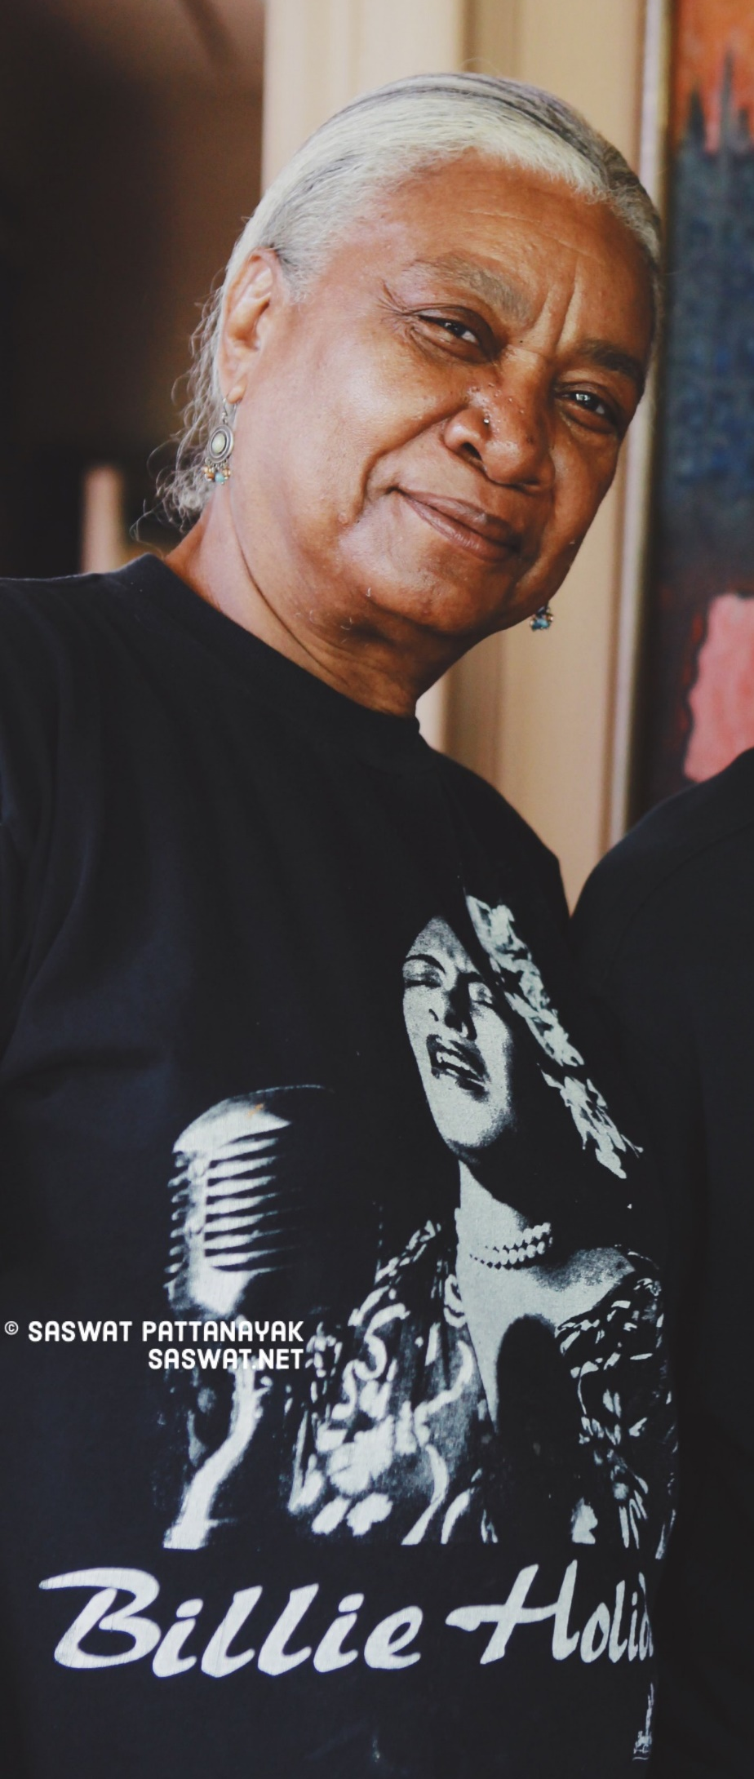
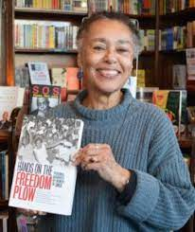

Slide 27
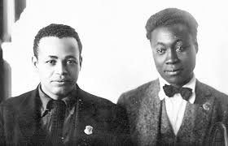
Otto Huiswoud (left) and Claude McKay (right) at the Fourth Congress of the Third International in Moscow in 1923.

Slide 28
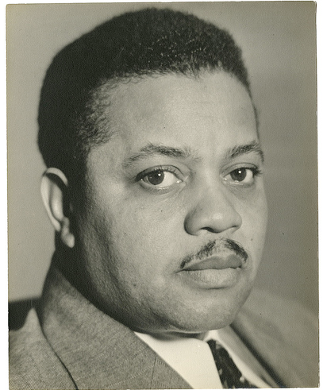
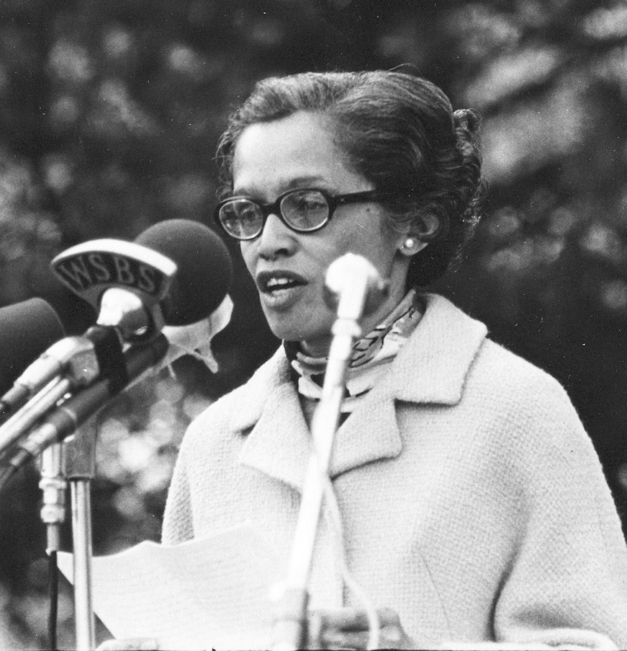
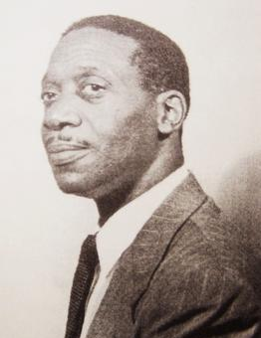
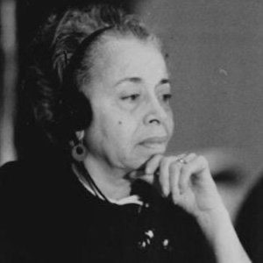
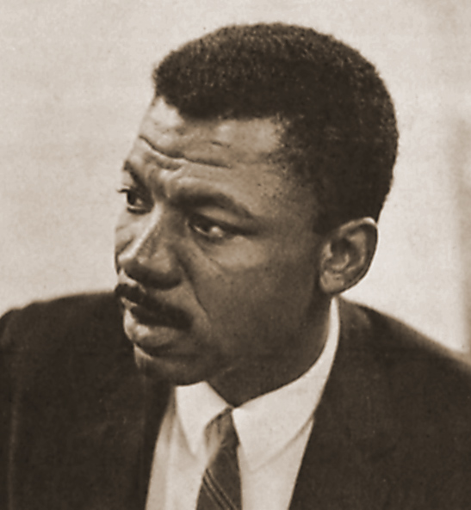
Leading Black
Communists

Slide 29
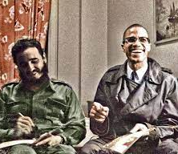

Slide 30
Historical context for Great Black Debates

Slide 37
Martin Luther King and Malcolm X

Slide 38
Black Radical Congress 1998
Founders: Barbara Ransby, Bill Fletcher,
Abdul Alkalimat, Leith Mullins, Manning Marable

Slide 39
What is 21st century consciousness?
The language of the past is insufficient, because people have changed – check the opinion polls.
The ideologies of the past continue as the foundation of Black social thought.
How can we change our thinking from what was relevant in the industrial society to relevance in the information society?

Slide 40
Summary
Black consciousness made a paradigm shift after the 1960s
It has reflected the Black Experience: color, class, culture, and gender
There have been five Black ideological traditions: Black liberation theory,
Pan Africanism, Black Nationalism, Womanism, and Socialism
There have been three great debates: Emancipation debate,
self-determination debate, and the Black liberation debate

