Slide 1
Welcome!
We’ll start a few
minutes after 10am
US Central Time

Slide 2
Gender
Abdul Alkalimat
IFA: Intro for all
Community Lecture #4
September 16, 2023

Slide 3
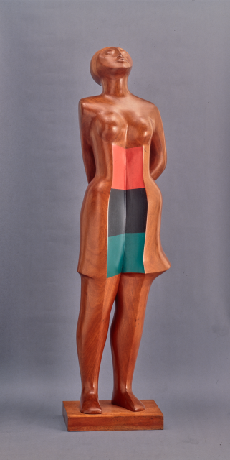
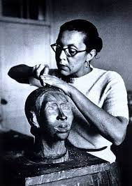
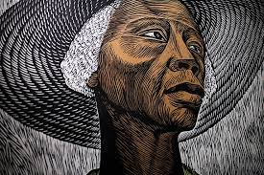
Outline
What is gender? Sex?
2. Struggles of Black women
3. End of binary gender
4. Current social crisis

Slide 4
Gender refers to the characteristics of women, men, girls and boys that are socially constructed. This includes norms, behaviours and roles associated with being a woman, man, girl or boy, as well as relationships with each other. As a social construct, gender varies from society to society and can change over time.
Gender is hierarchical and produces inequalities that intersect with other social and economic inequalities. Gender-based discrimination intersects with other factors of discrimination, such as ethnicity, socioeconomic status, disability, age, geographic location, gender identity and sexual orientation, among others. This is referred to as intersectionality.
World Health Organization
In the study of human subjects, the term sex should be used as a classification, generally as male or female, according to the reproductive organs and functions that derive from the chromosomal complement [generally XX for female and XY for male].
Yale University School of Medicine

Slide 5
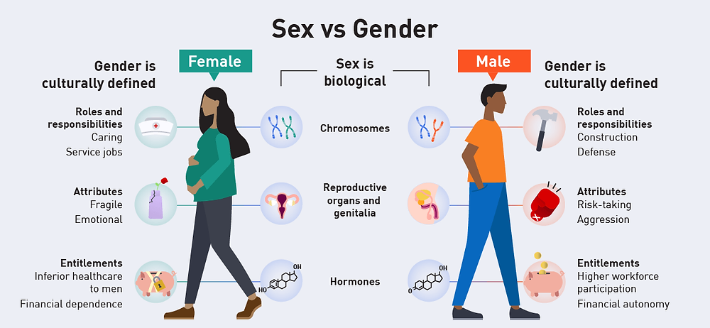
Biology vs Sociology
(Sex)
(Gender)

Slide 6
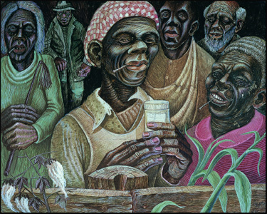
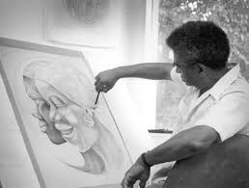
Women have been the foundation of community social and institutional life. They lead in production and the social reproduction. This amounts to two fulltime jobs. However, within the community male supremacy is a major problem today.

Slide 7
The logic of Black history: modes of social cohesion, modes of social disruption
Africa
Slave trade
Slavery
Emancipation
Rural tenancy
Great migrations
Urban industry
Structural crisis
Information society

Slide 8
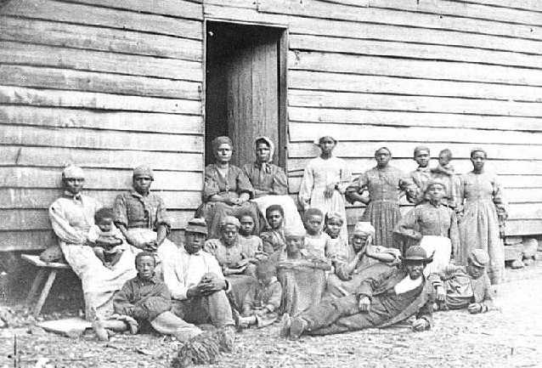
The slave experience of Black women

Slide 9
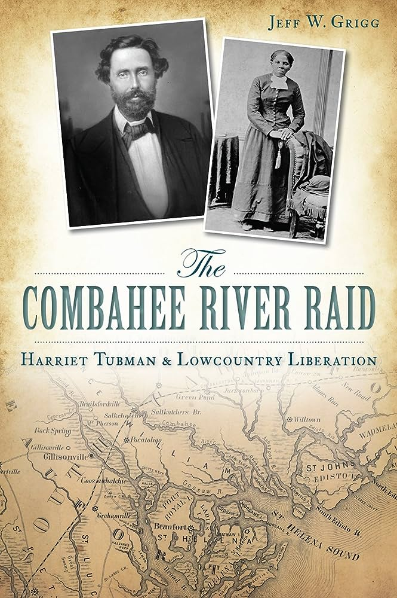
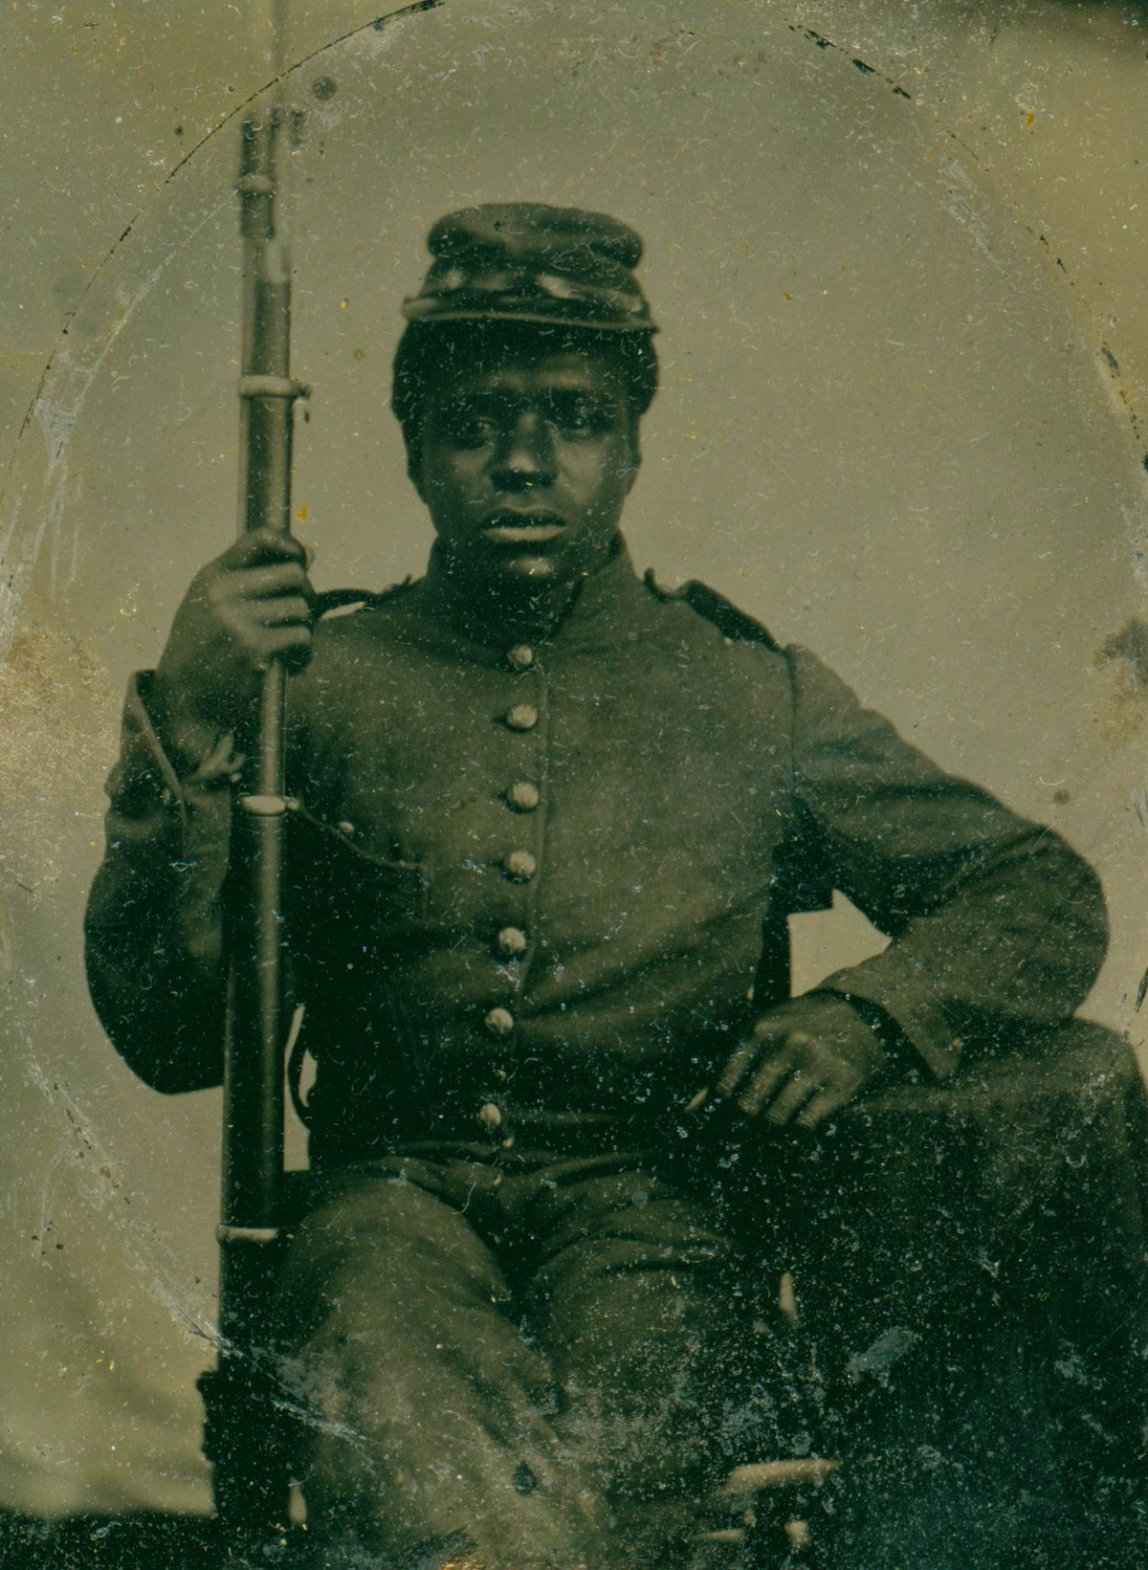
On June 2, 1863, Harriet Tubman, under the command of Union Colonel James Montgomery, became the first woman to lead a major military operation in the United States when she and 150 African American Union soldiers rescued more than 700 slaves in the Combahee Ferry Raid during the Civil War.

Slide 10
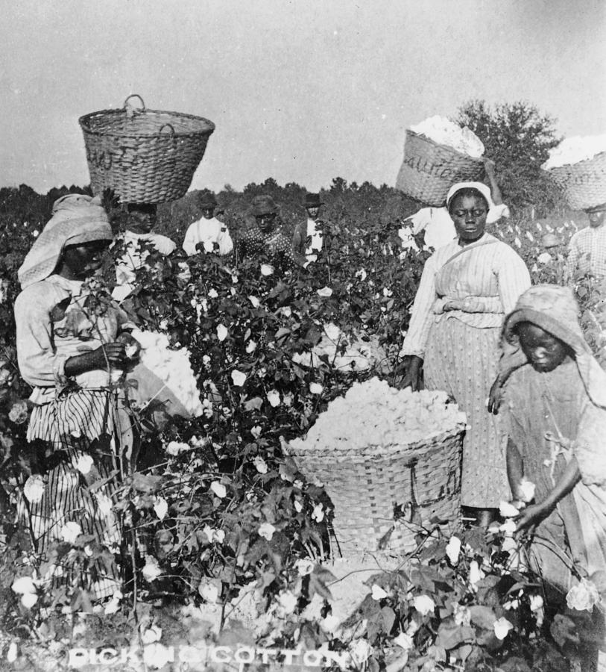
The rural tenant experience of Black women

Slide 11
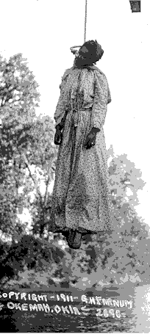
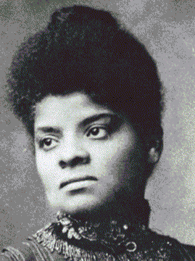
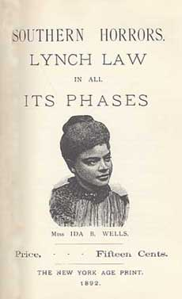
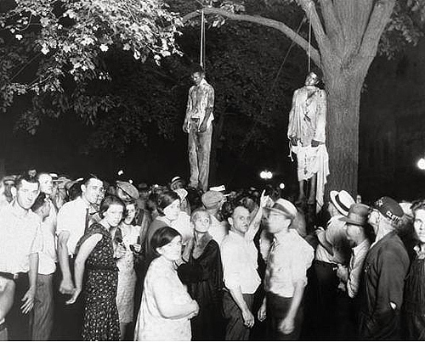
Ida B. Wells
Vs
Lynching

Slide 12
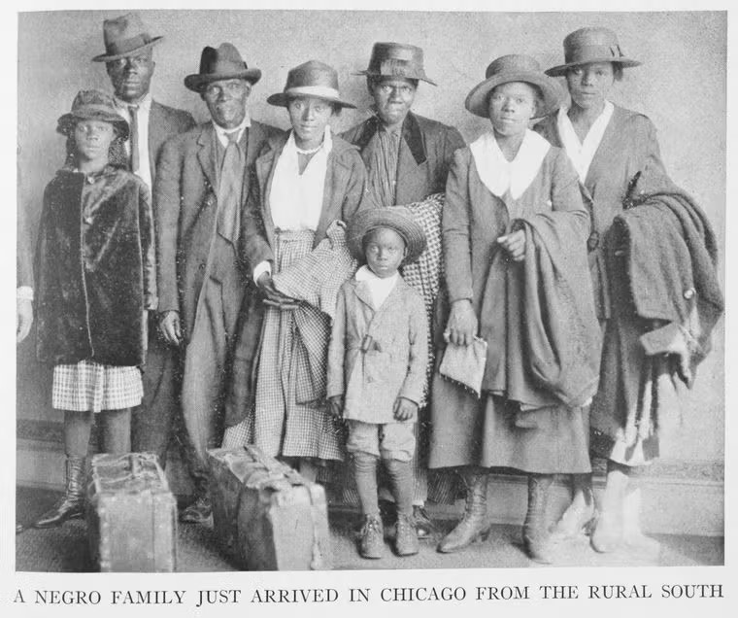

Slide 13
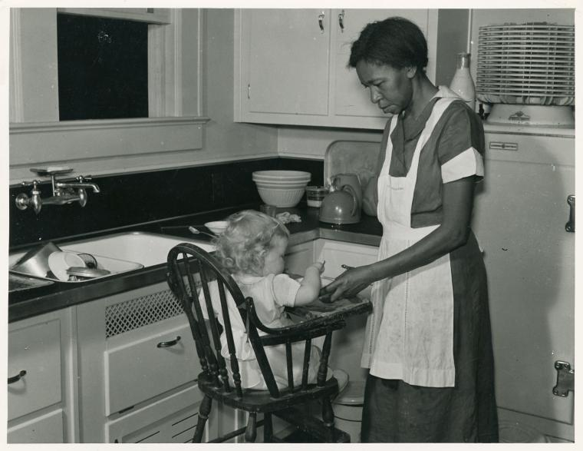
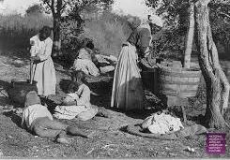
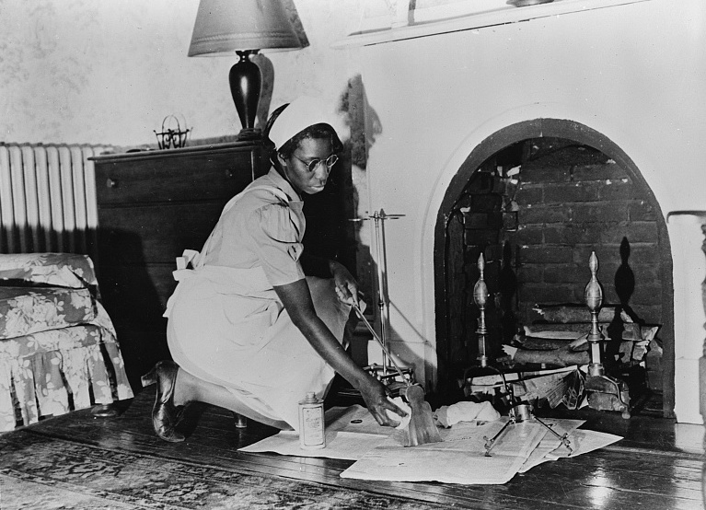
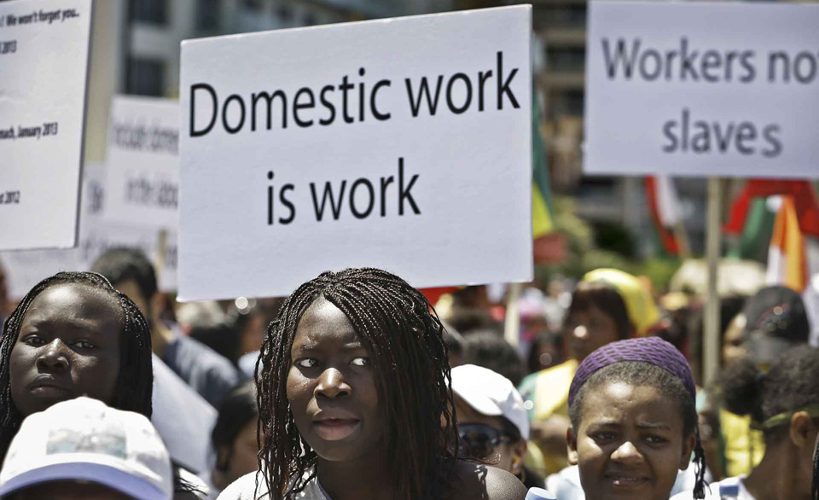
Women forced to work as domestics

Slide 14
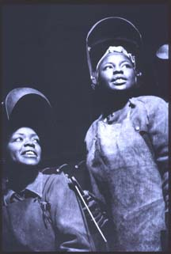
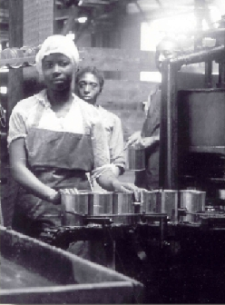
The urban Industrial experience of Black women.

Slide 15
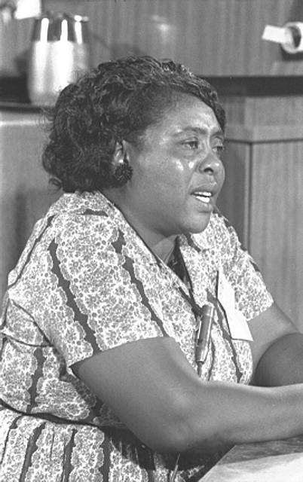
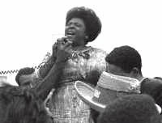
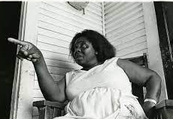
Fannie Lou Hamer 1917 - 1977

Slide 16
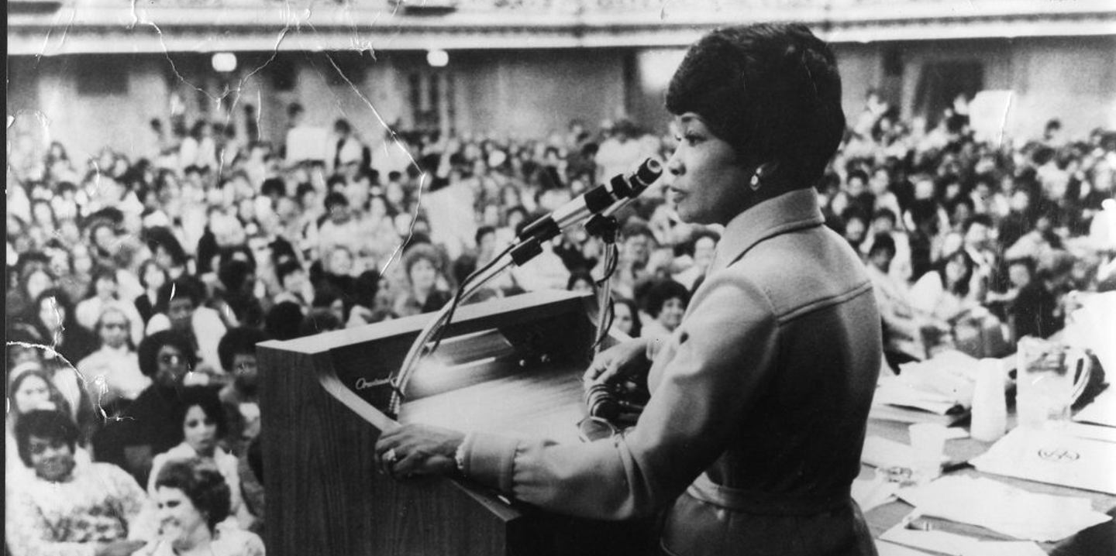
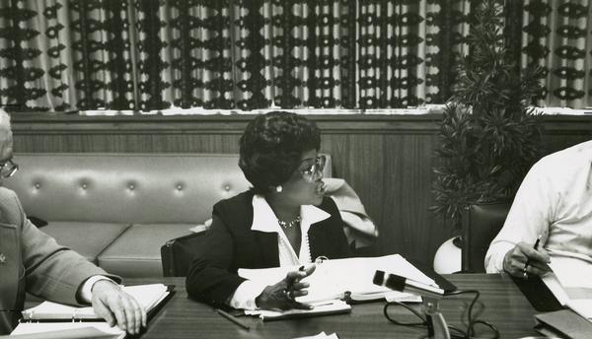
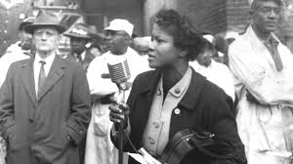
Addie Wyatt (1924 – 2012)

Slide 17
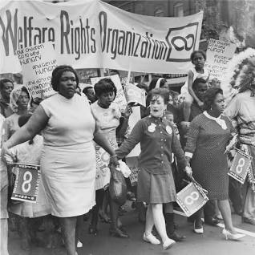
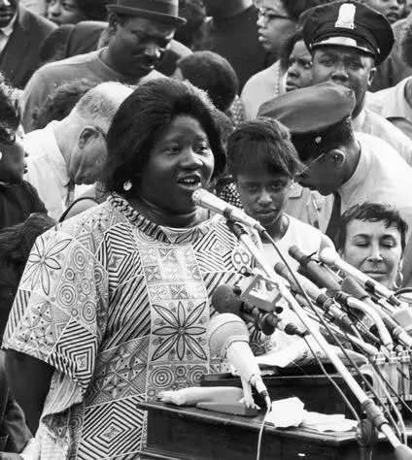
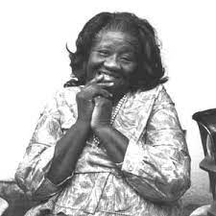
Johnnie Tillmon
(1926 – 1995)

Slide 18
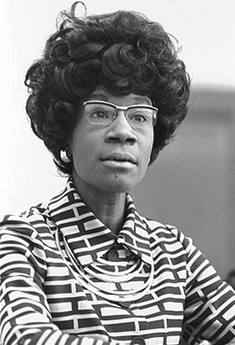
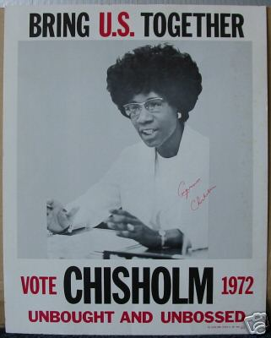
Shirley Chisholm
(1924 – 2005)

Slide 19
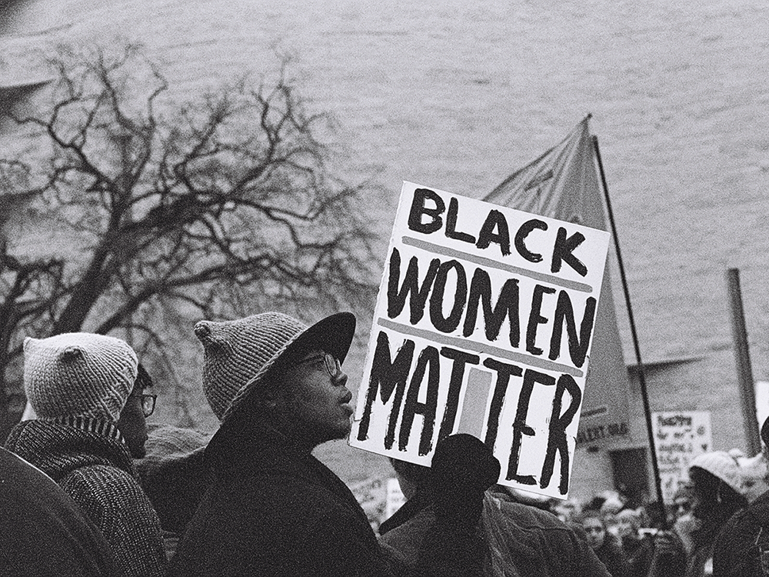
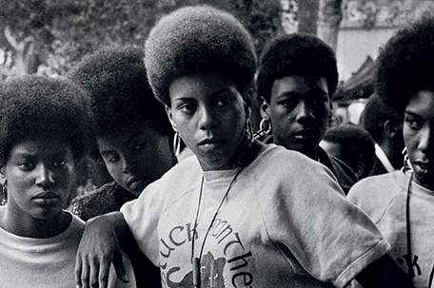
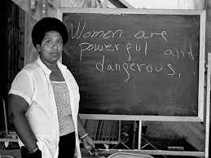
The most disrespected person in America is the Black woman, the most unprotected person in America is the Black woman, the most neglected person in America is the Black woman. Malcolm X

Slide 20
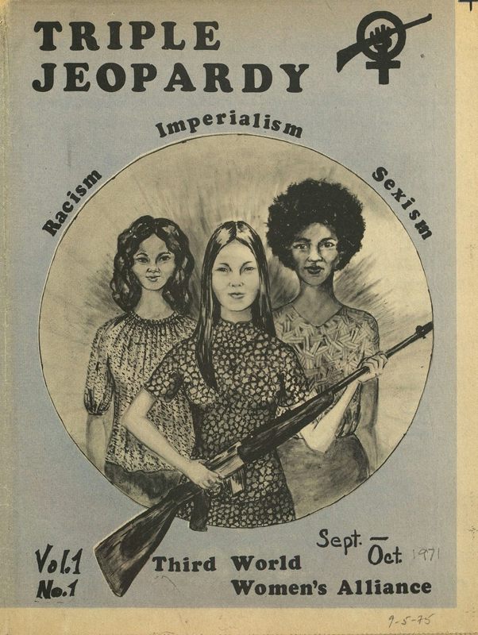
Black Women Face Triple Oppression
Class, Color, Gender
Triple oppression, also called double jeopardy, Jane Crow, or triple exploitation, is a theory developed by Black socialists in the United States, such as Claudia Jones. The theory states that a connection exists between various types of oppression, specifically classism, racism, and sexism. It hypothesizes that all three types of oppression need to be struggled against at the same time.

Slide 21
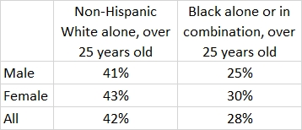
Educational attainment
of at least college

Slide 22
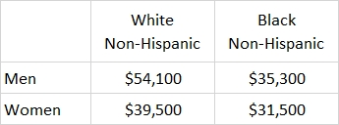
Median annual earnings
Ages 20-59
2019-2020

Slide 23
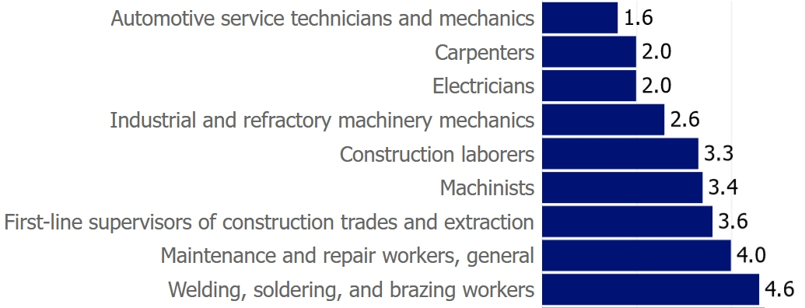
20 gendered occupations

Slide 24
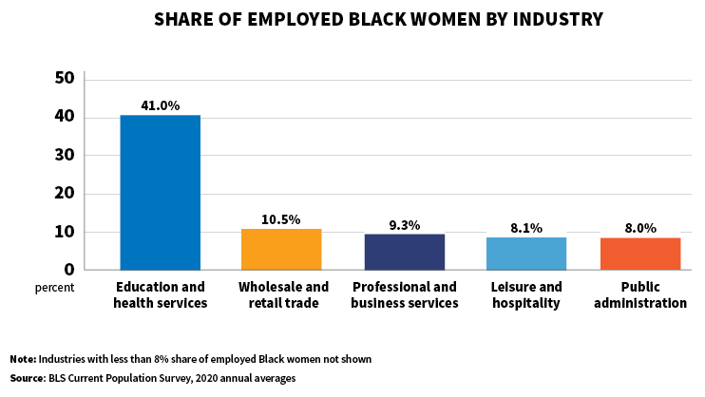
Where do Black women work?

Slide 25
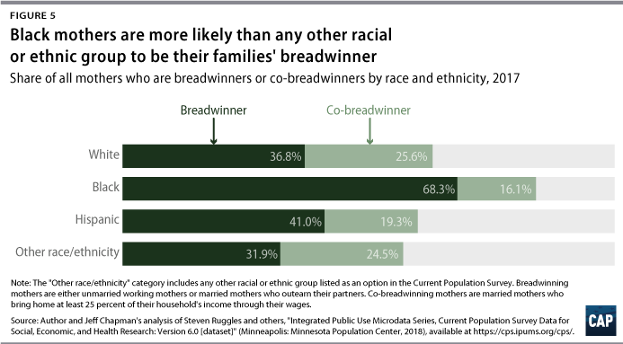
Black Mothers

Slide 26
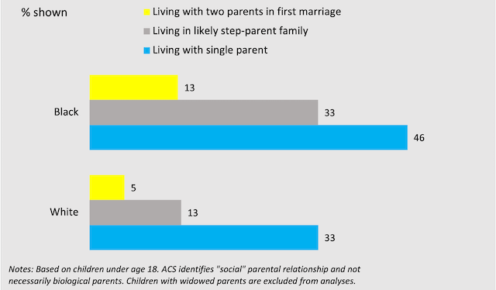
Higher poverty for all kinds of Black families

Slide 27
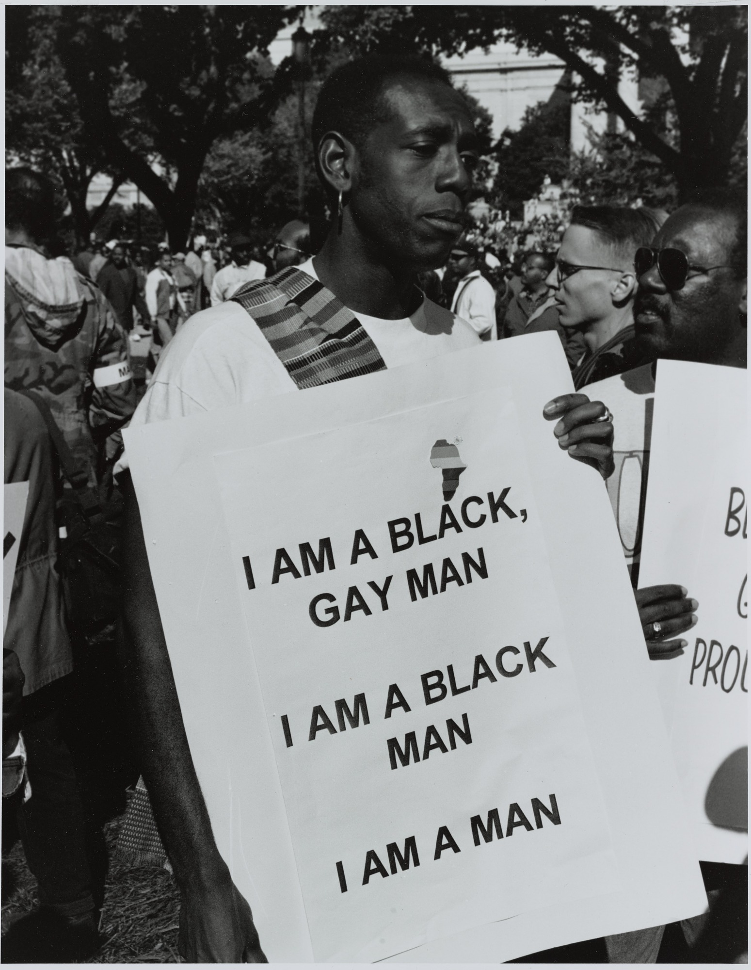
LGBTIQA+ stands for "lesbian, gay, bisexual, transgender, intersex, queer/questioning, asexual and many other terms (such as non-binary and pansexual)

Slide 28
From Left (top) Audre Lorde, Angela Davis, Miss Major,
Lorraine Hansberry, Barbara Jordan, (bottom) Storme
DeLarverie, Joan Jett Blakk, Bayard Rustin

Slide 29
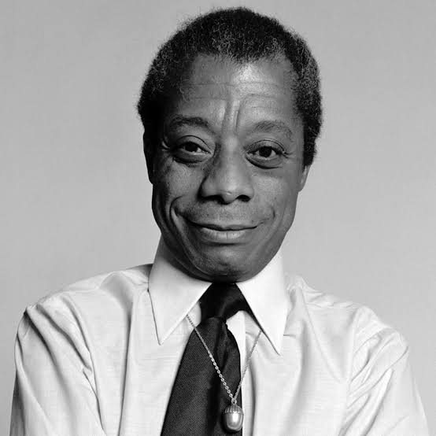
“But the true feminist deals out of a lesbian consciousness whether or not she ever sleeps with women.” ― Audre Lorde
Love him and let him love you. Do you think anything else under heaven really matters
James Baldwin

Slide 30
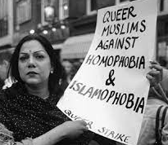
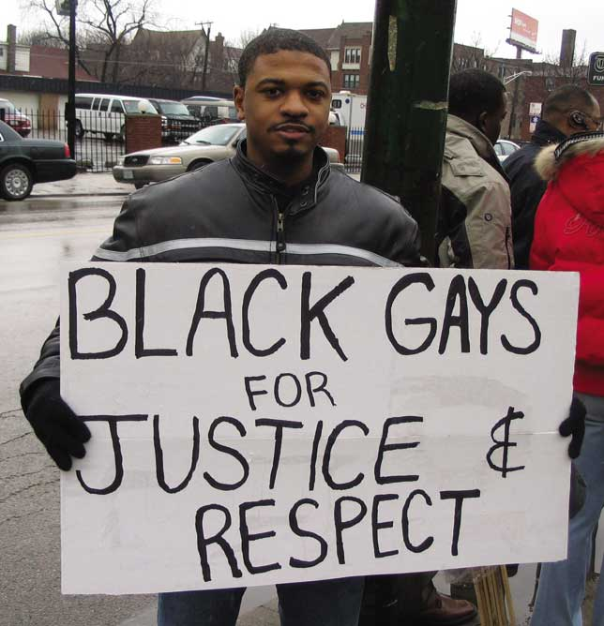
Homophobia:
Discriminatory and dangerous
All Brothers and Sisters must be protected

Slide 31
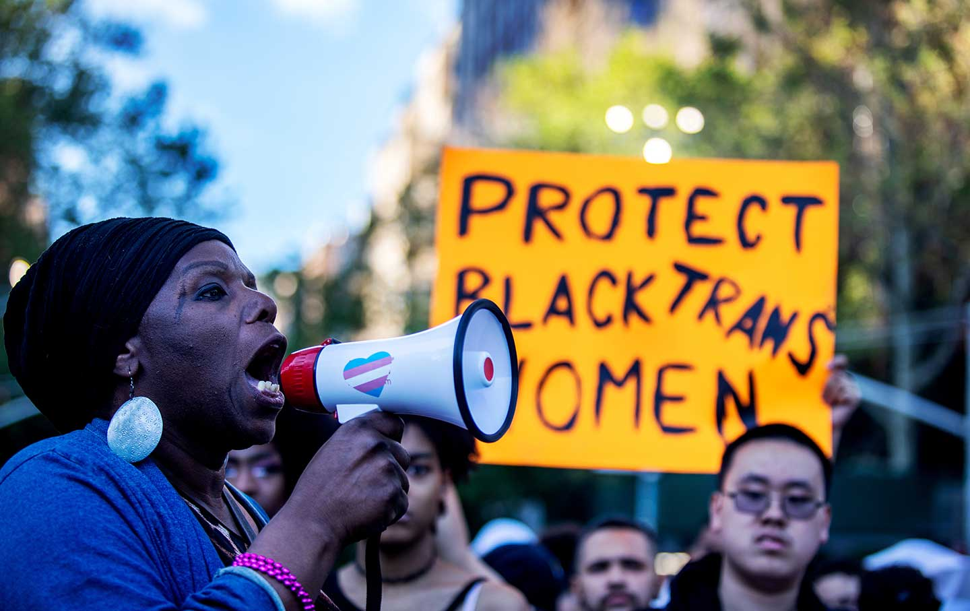
All Brothers and Sisters must be protected

Slide 32
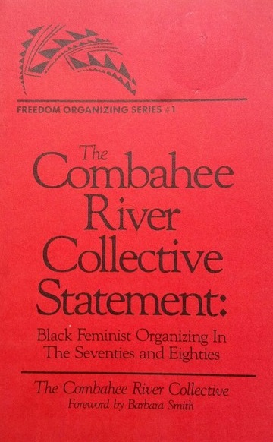
We are a collective of Black feminists who have been meeting together since 1974. [1] During that time we have been involved in the process of defining and clarifying our politics, while at the same time doing political work within our own group and in coalition with other progressive organizations and movements. The most general statement of our politics at the present time would be that we are actively committed to struggling against racial, sexual, heterosexual, and class oppression, and see as our particular task the development of integrated analysis and practice based upon the fact that the major systems of oppression are interlocking. The synthesis of these oppressions creates the conditions of our lives. As Black women we see Black feminism as the logical political movement to combat the manifold and simultaneous oppressions that all women of color face.
The Combahee River Collective Statement (1977)

Slide 33
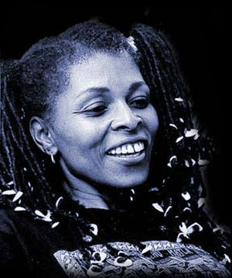
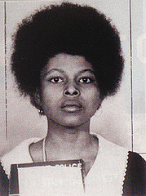
Black women in the Black
liberation movement continues

Slide 38
Black women in political leadership: 29 Black women – all Democrats – serve in the 118th Congress. Kamala Harris (D-CA) serves as vice-president. Ketanji Brown Jackson serves on the Supreme Court.

Slide 39
Militant Black
Women leaders

Slide 40
Summary
We must understand the difference between
gender and sexuality
Black women have suffered in history
Black women have been leaders
Black women face triple oppression
We must defend the LGBTQIA community
We must support Black women in electoral
positions and in mass social movements

