Slide 1
Welcome!
We’ll start a few
Minutes after 10am
US Central Time

Slide 2
Culture
Abdul Alkalimat
IFA: Intro for all
Community Lecture #3
September 9, 2023

Slide 3
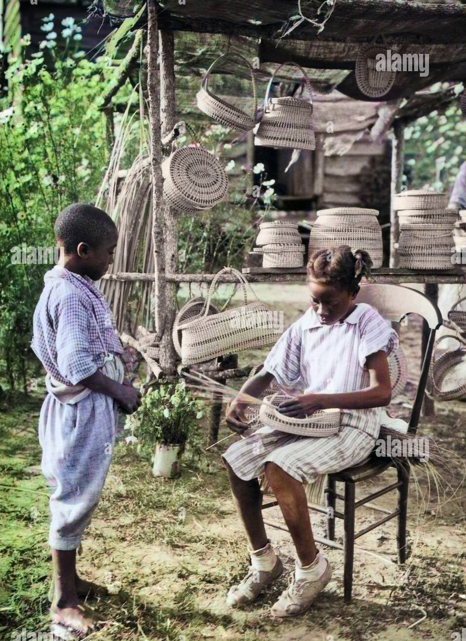
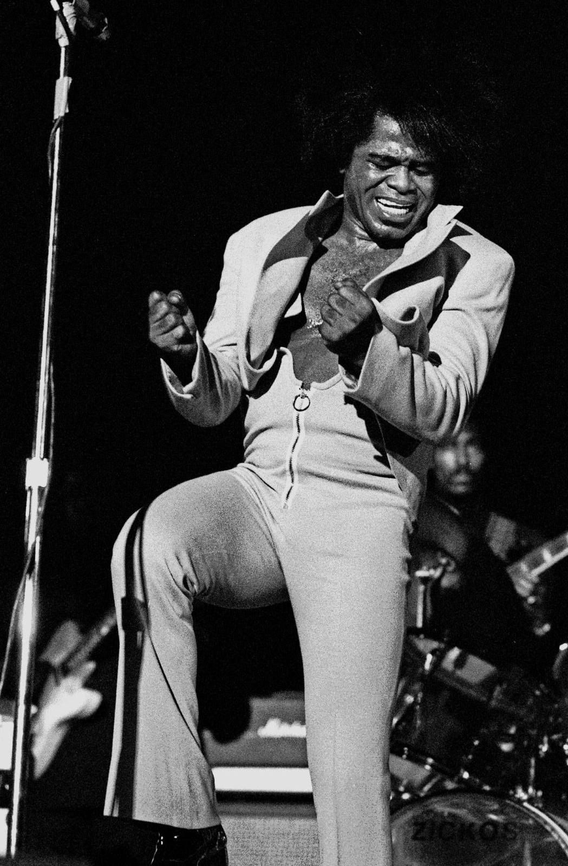
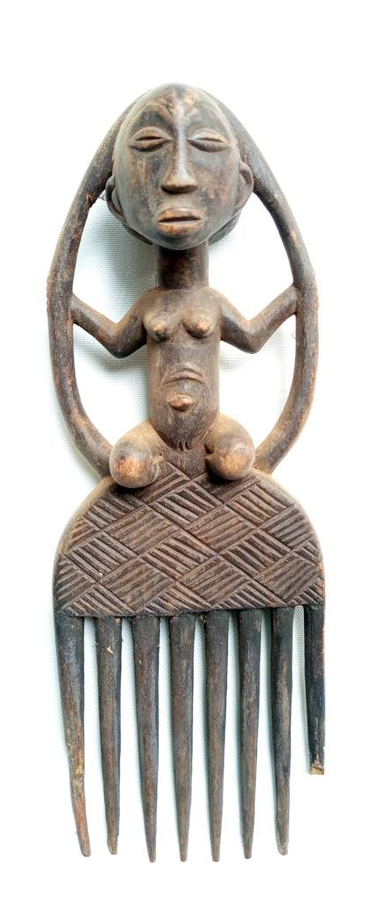
Outline
A definition
Origin
Everyday Life
History
Art

Slide 5
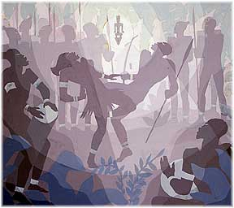
Two perspectives on culture
Styles and values of everyday life, including dialects, food production and preparation, clothing, dancing, morality, and aesthetics
Art forms, representational forms of expression carried out as specialized activity that require high levels of skill
Aaron Douglas, The Warriors Dance

Slide 6
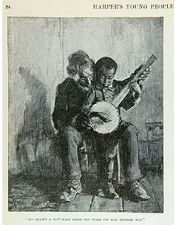
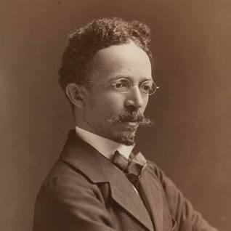
Elements of Everyday Culture
Recreation
Norms
Values
Style
Customs
Rituals
Tradition
Henry Ossawa Tanner
1859 - 1937

Slide 7
The logic of Black history: modes of social cohesion, modes of social disruption
Africa
Slave trade
Slavery
Emancipation
Rural tenancy
Great migrations
Urban industry
Structural crisis
Information society

Slide 8
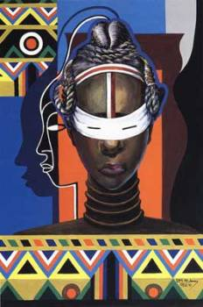
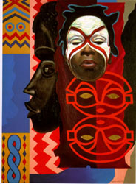
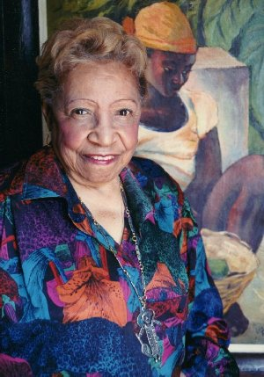
African retention is a vital aspect of African American culture
Lois Mailou Jones
1905-1998
This includes aesthetics, religion, language, food, music and dancing, hair care and styling, and much more

Slide 9
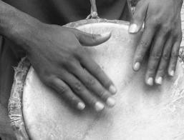
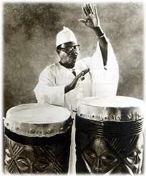
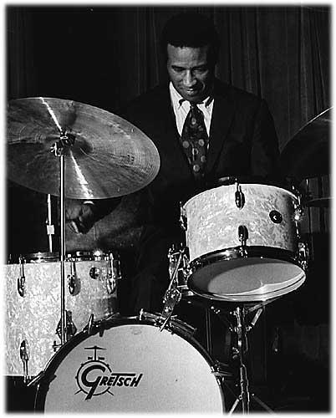
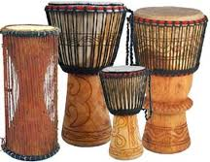
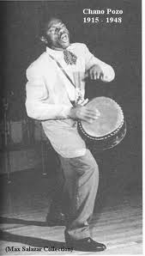
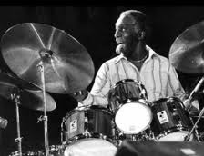
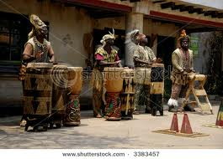

Slide 10
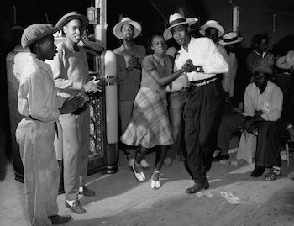
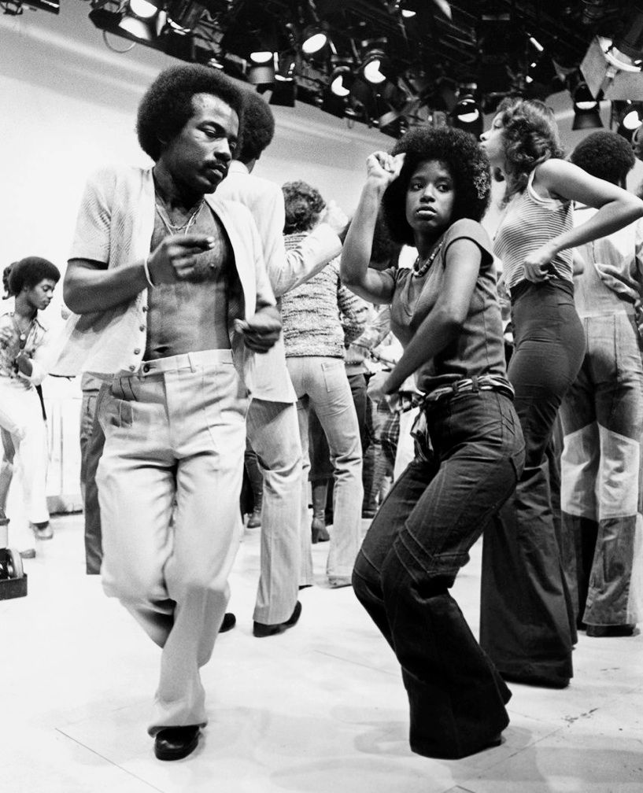
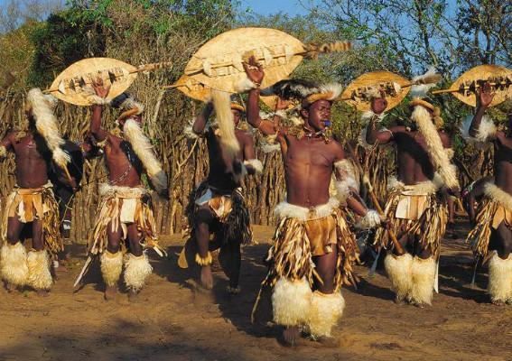
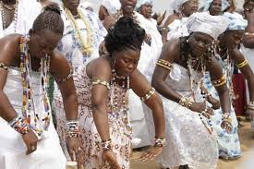
Moving our bodies in dance is cultural performance

Slide 11
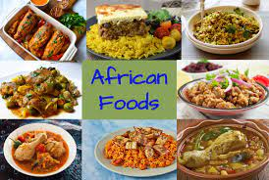

Slide 12
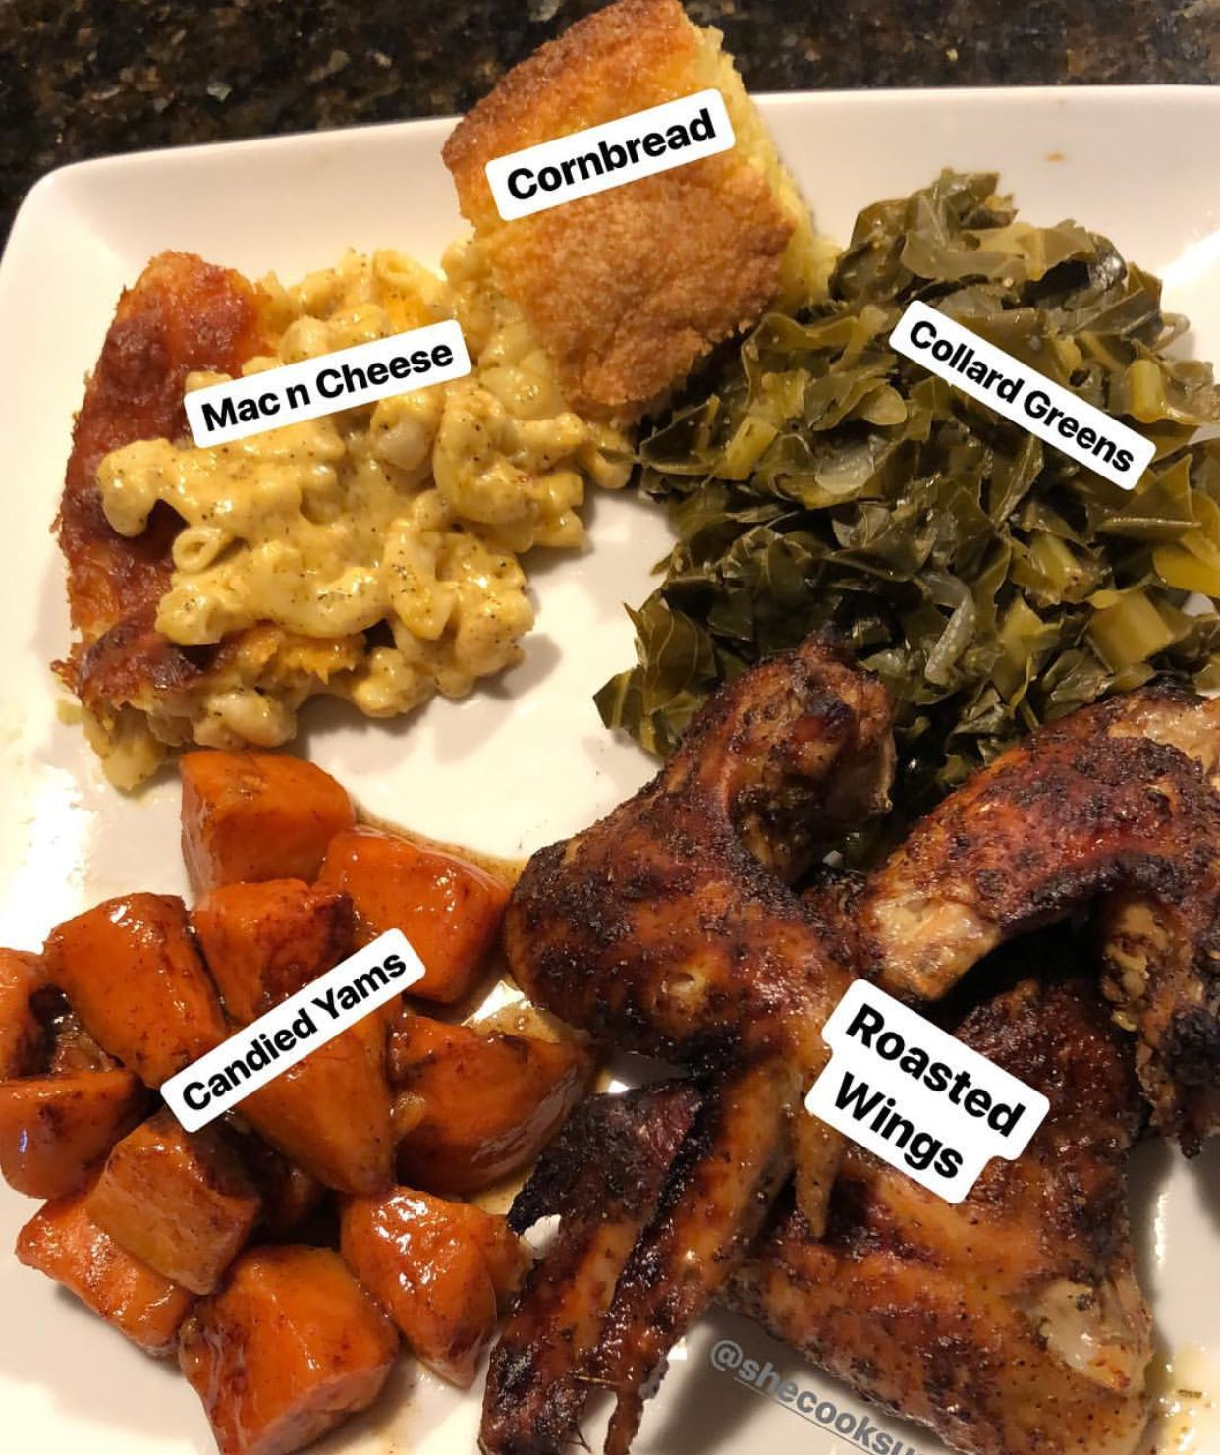
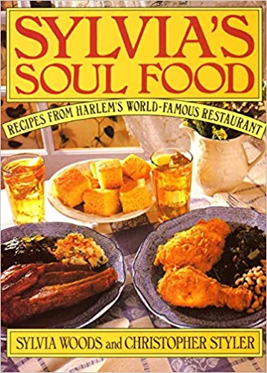
African American Food

Slide 13
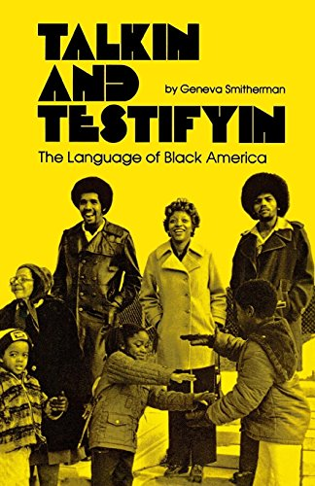
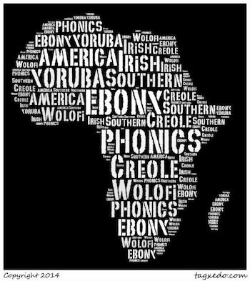
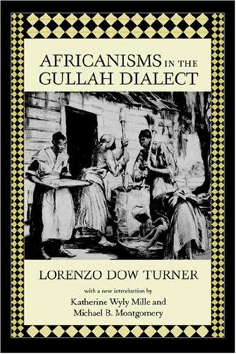
Language/Speaking is a cultural act
Every culture makes sense to itself

Slide 14
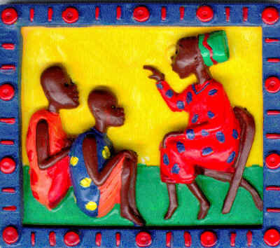
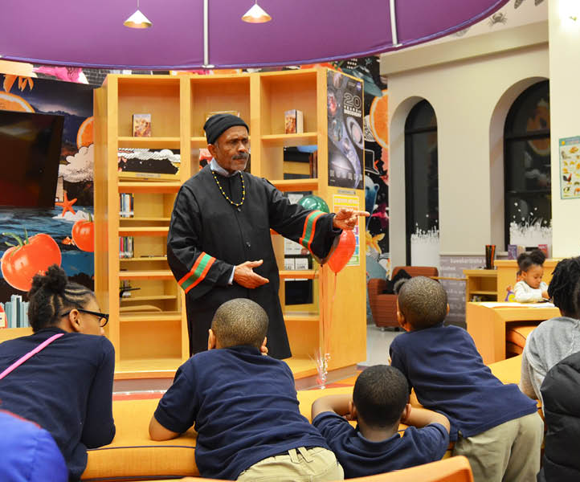
Nommo:
Words can create harmony
Telling stories is the performance of culture
through generational transmission

Slide 15
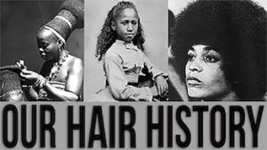

Slide 16
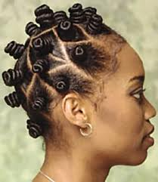
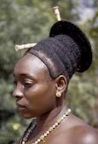
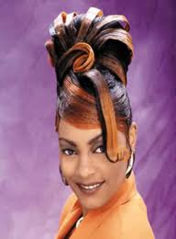
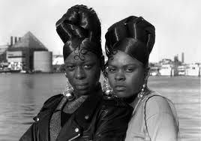
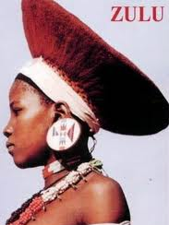

Slide 17
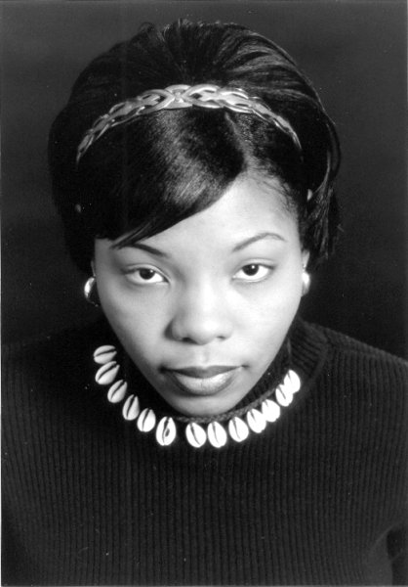
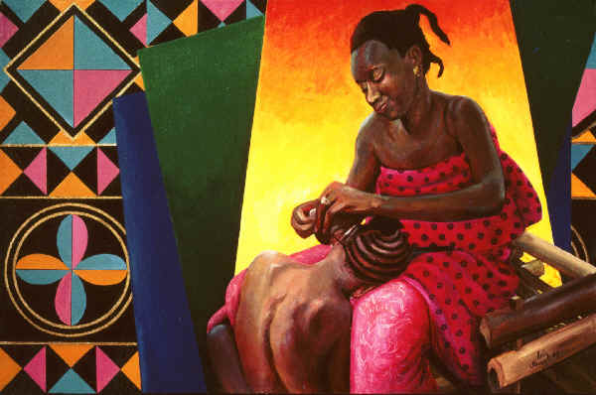
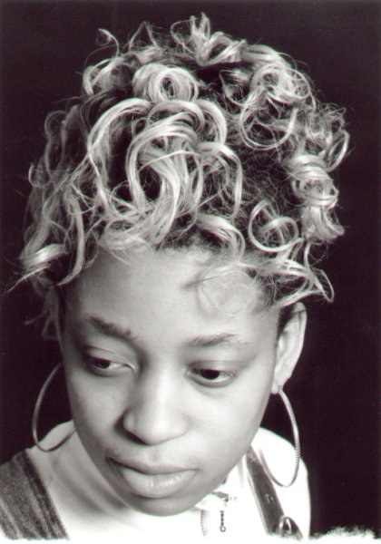
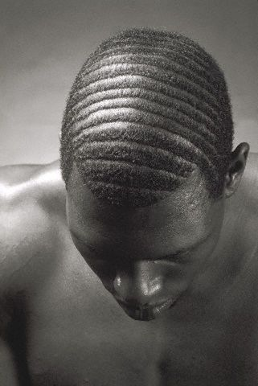
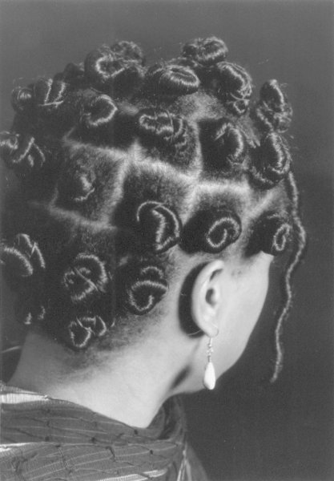
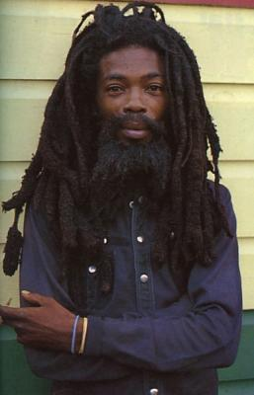
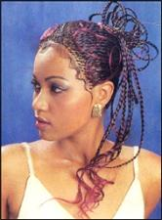
Culture always involves hair

Slide 18
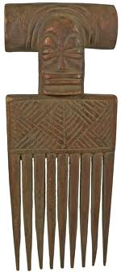
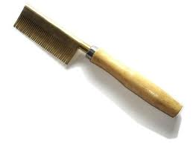
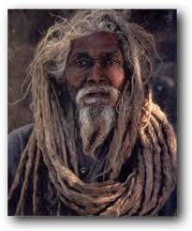
2.
3.
1.
1. Traditional African comb
2. Industrial “hot” comb
3. PanAfrican comb
4. Global comb
4.

Slide 19
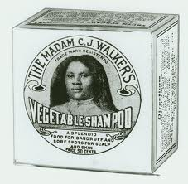
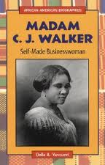
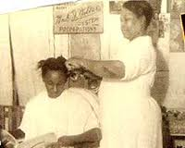
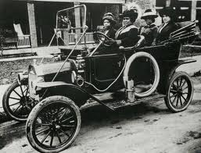
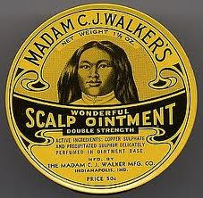
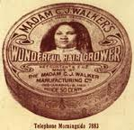

Slide 22
Our clothing expresses our culture

Slide 23
Style is a cultural act.
We take clothes and
make them our own.

Slide 24
Cultural innovation during slavery
Cotton production and brutality conditioned Black people
to harness their emotions and focus on describing their suffering, while praising God.

Slide 25
The “Negro spiritual” was the greatest cultural genius during slavery
The low moans and melodies of Black Christians revealed the soul of a new people, out of Africa and being reshaped by the pain of white racism and creative Black genius. The Fisk Jubilee singers popularized these songs all over the world.
Original Fisk University Jubilee Singers
John Work II and III

Slide 26
Culture of the Black Belt Nation
BLUES – the musical foundation of African American culture and all of American popular music. This music is important as musical composition, as poetry and as philosophy. The harder the life, the better the blues.

Slide 28
Mahalia Jackson, Thomas Dorsey, the Staple Singers
Gospel music
Anchors
The church
As a total
cultural
institution

Slide 29
JAZZ (Black classical music): The culture of the Black metropolis
Edward “Duke” Ellington
1899-1974

Slide 30
The Harlem Renaissance, 1920’s
This is the Black counterpart to the “Roaring 20’s” as Black people were expressing a breakout cultural impulse. These were bold and exciting times. The activists were called “New Negroes,” with a militant attitude and freedom on their mind. Harlem was the capital of Blacks in the US during this period.

Slide 31
The Negro Speaks of Rivers
By Langston Hughes
I
I’ve known rivers ancient as the world and older than the flow of human blood in human veins. My soul has grown deep like the rivers. I bathed in the Euphrates when dawns were young. I built my hut near the Congo and it lulled me to sleep. I looked upon the Nile and raised the pyramids above it. I heard the singing of the Mississippi when Abe Lincoln went down to New Orleans, and I’ve seen its muddy bosom turn all golden in the sunset. I’ve known rivers: Ancient, dusky rivers. My soul has grown deep like the rivers.
Langston Hughes 1902-1967

Slide 32
Militant Black Poetry Became Iconic
If we must die, let it not be like hogs Hunted and penned in an inglorious spot, While round us bark the mad and hungry dogs, Making their mock at our accursed lot. If we must die, O let us nobly die, So that our precious blood may not be shed In vain; then even the monsters we defy Shall be constrained to honor us though dead! O kinsmen we must meet the common foe! Though far outnumbered let us show us brave, And for their thousand blows deal one deathblow! What though before us lies the open grave? Like men we'll face the murderous, cowardly pack, Pressed to the wall, dying, but fighting back!
Claude McKay
1890-1948

Slide 33
The Chicago Renaissance, 1940’s
The Harlem Renaissance was a celebration of the middle class, while the Chicago Renaissance of the 1940’s was a celebration of the working class.
Wright wrote: “…the Negro writer must create in his readers’ minds a relationship between a Negro woman hoeing cotton in the South and the men who toil in swivel chairs in Wall Street and take the fruits of her toil.”
Richard Wright 1908-1960

Slide 34
Bebop was new music in the 1940’s
Charlie Parker and Dizzy Gillespie (above), Thelonious Monk (right)

Slide 35
Billy Holiday (1915 – 1959)
Charlie Parker (1920 - 1955

Slide 36
The Black Arts Movement, 1960’s
The Black arts movement was the cultural arm of the Black Power movement. Jeff Donaldson said, "We wanted to try to establish an aesthetic that reflected our heritage as people of African descent in the United States, an aesthetic that also reflected social responsibility and technical excellence."
Jeff Donaldson
1932-2004

Slide 37
The Black Arts Movement is radically opposed to any concept of the artist that alienates him from his community. This movement is the aesthetic and spiritual sister of the Black Power concept. As such, it envisions an art that speaks directly to the needs and aspirations of Black America. - Larry Neal (1968)

Slide 38
Major Black Poets:
Amiri Baraka, Amus Mor,
Sonja Sanchez, Jayne Cortez

Slide 39
Black Power was expressed in the music of John Coltrane

Slide 40
Hip Hop emerged as the next major cultural movement after the 1960’s –conscious victims of the American dream.

Slide 41
Corporate takeover of Black culture
The carnival festival: originally a slave ritual protest, expression of freedom
Now Mardi Gras and Carnival is controlled by city governments, police, and financial interests. Is hip hop any different?

Slide 42
However, we have cultural institutions:
museums, art galleries, libraries, restaurants, schools, churches
(Is Black autonomy possible in capitalist America?)

Slide 43
Summary
Culture is what makes us human
The origin of Black culture is Africa
Fundamentals of culture are in everyday life
Culture goes through historical changes
Art is the highest form of cultural production

