Slide 1
Welcome!
We’ll start a few
Minutes after 10am
US Central Time

Slide 2
Class
Abdul Alkalimat
IFA: Intro for all
Community Lecture #2
September 2, 2023

Slide 3
How to participate in the discussion?
More than 250 people have registered and more than 100 want to comment. There are several ways to do so. Our time is limited to 90 minutes, including 45 minutes of presentation.
During the discussion time, raise your hand to start the discussion with short (<4 min) comments (with video, thanks) (use the “reactions” button and “raise hand”)
Anytime during the session, write your comments, questions, links etc. in the chat
Take the discussion into your classes, your networks and all other Black Studies contexts
We look forward to our collective intelligence.

Slide 4
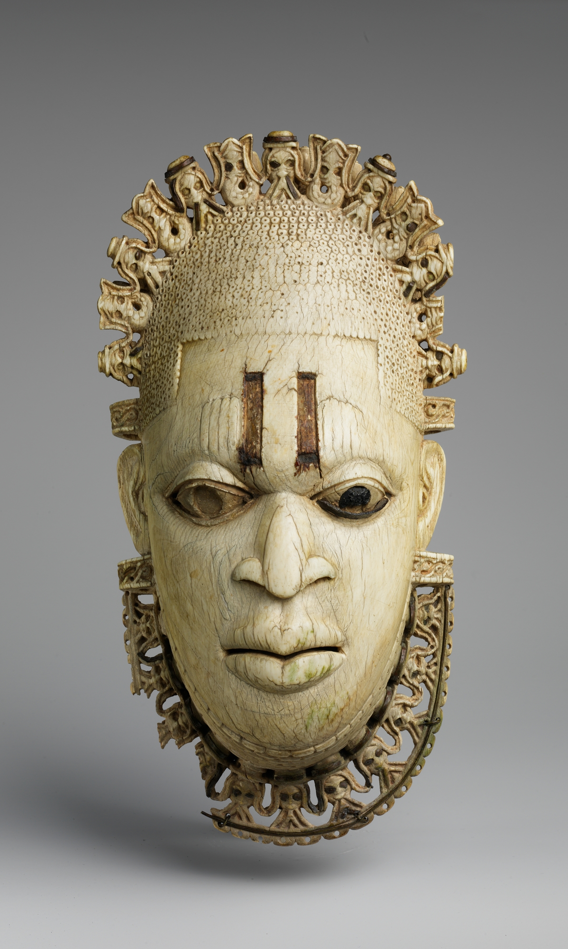
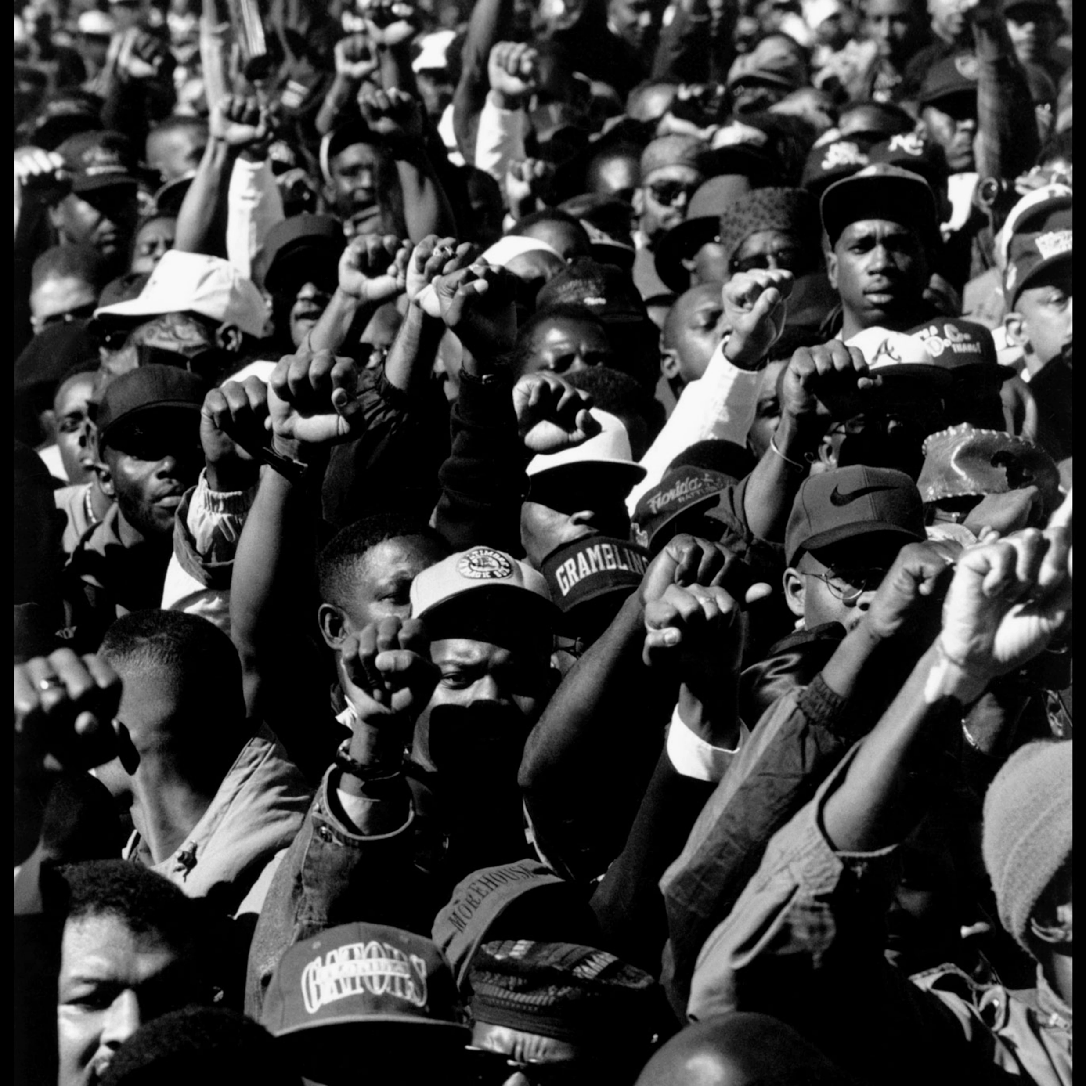
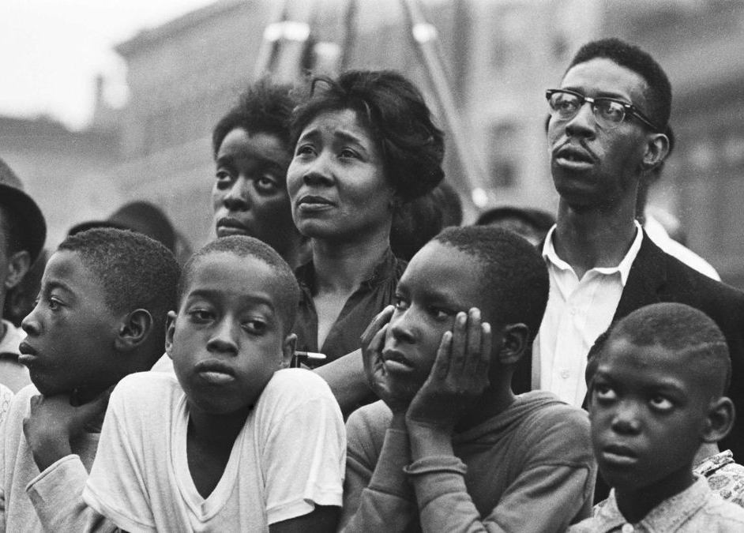
What is a social class?
Two approaches to class
Class in Black history
Class structure of Black people today
Class struggle and Black liberation

Slide 5
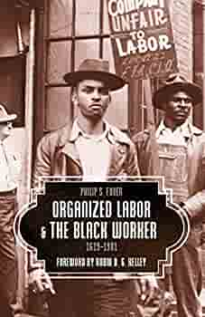
Class is the way a society is organized.
Everyone has a class position.
Not everyone understands their class position
Some people have false consciousness.
Class consciousness is needed for social change

Slide 6
Class is about two aspects of life:
Quality of life
Power

Slide 7
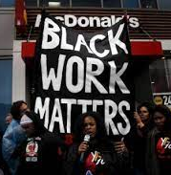
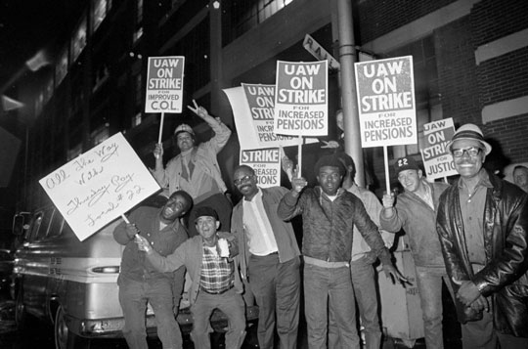
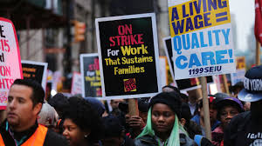
Two alternative approaches to class
Social Stratification (quality of life)
a. Objective: ranking people by income and/or educational attainment
b. Subjective: ranking people by social status, including occupational prestige
Political economy (power)
a. Objective: ownership and control of the means of production versus labor
b. Subjective: capitalist production of false consciousness to suppress labor

Slide 8
Black Studies approach to class
Use both approaches: stratification and political economy
2. All studies of class should be based on empirical data
3. Studies should clarify different classes in the Black community
4. Studies should clarify differences between Blacks and Whites in the same class
5. Studies should make comparisons throughout Africa and the African Diaspora
Are you in this picture? We need to study

Slide 9
Who benefits from a $15 national
minimum hourly wage increase?
One third of all workers and 47% of Black workers.

Slide 10
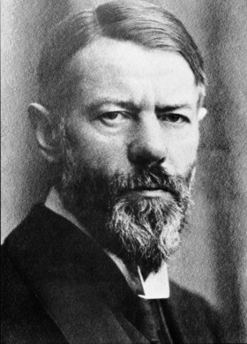
Max Weber 1864-1920
The systems of class, status and party are all at work. The main issue is ones market position, social standing in the community, and role in the political process.

Slide 11
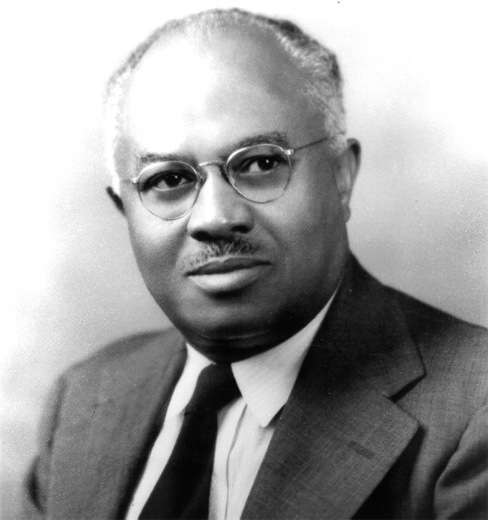
E. Franklin Frazier 1894-1962
The stratification of the Black population can be described best by income, educational, and occupational status. In addition, the cultural values of different classes have to be considered.

Slide 12
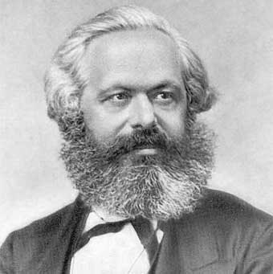
Karl Marx 1818-1883
Every stage of history is shaped by technology and the struggle between the owners and the workers. The struggle is for power over the means of production to run the economy and the state, including the military and the police.

Slide 13
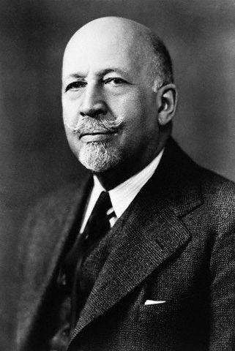
W. E. B. Du Bois 1868-1963
DuBois combined a study of political economy, sociology and history. He analyzed the Civil War and Reconstruction in terms of class struggle. In 1921 he stated he favored for Blacks what had happened in Russia in 1917.

Slide 14
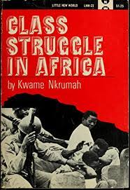
“[The] association of wealth with whites and poverty with blacks is not accidental.” Walter Rodney
Class Struggle in African History

Slide 15
The rich are only defeated when running for their lives.
C.L.R. James
Class Struggle in Caribbean History

Slide 16
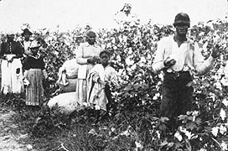
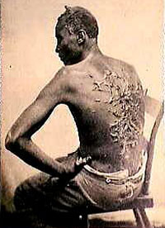
History of class and class struggle: Slavery and capitalism
The main class relations were slaves and the owners of slaves. The rule of the slave master was by brutal force. The majority of slave owners had few slaves, but the power was in the hands of the big plantation owners. Slavery was an engine of the capitalist system as well as an obstacle to its development. What was the role of technology?

Slide 17
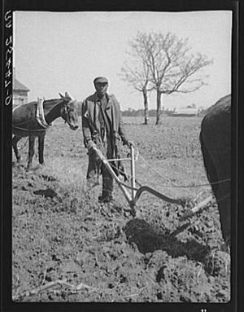
History of class and class struggle: Sharecropping and the National Question
The African American nation was formed in the Black Belt South, based on family labor, church organization, blues and African retentions. The main factors were rural isolation, concentration, and exploitation. What was the role of technology?

Slide 18
History of class and class struggle: Black industrial workers and changes in the Black Middle Class
Two Great Migrations led to Black workers being concentrated in northern cities. This was a radical transformation from South to North, from rural to urban, from agricultural to industrial. Time changed, literacy requirements changed, and family structure changed. Ghetto businesses opened.

Slide 19
Social Class and Black People 2023
The Black capitalist class: main income from ownership, especially stocks
The Black middle class: main income from professional jobs and family businesses
The Black working class: main income from jobs with little freedom of decision making
The Black anti-class: main income insecure from government and underground economy

Slide 20
The Black capitalist class
Over three quarters (76 percent) of public Fortune 1,000 companies had at least one African American director on their board as of September 2022, compared with 61 percent at the end of 2020.
Forty percent of the African American directors joined their boards aafter June 1, 2020 showing progress since the murder of George Floyd in May 2020.
John Johnson 1918-2005

Slide 21
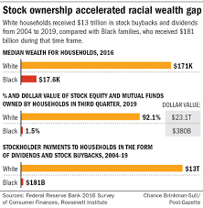
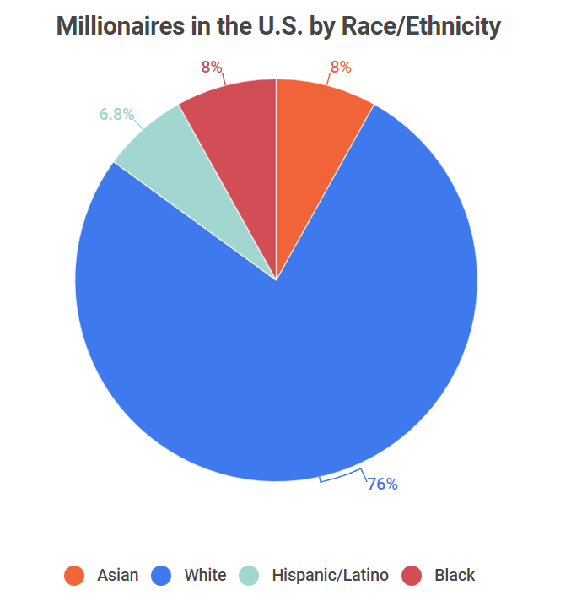
Black
Capitalism

Slide 22
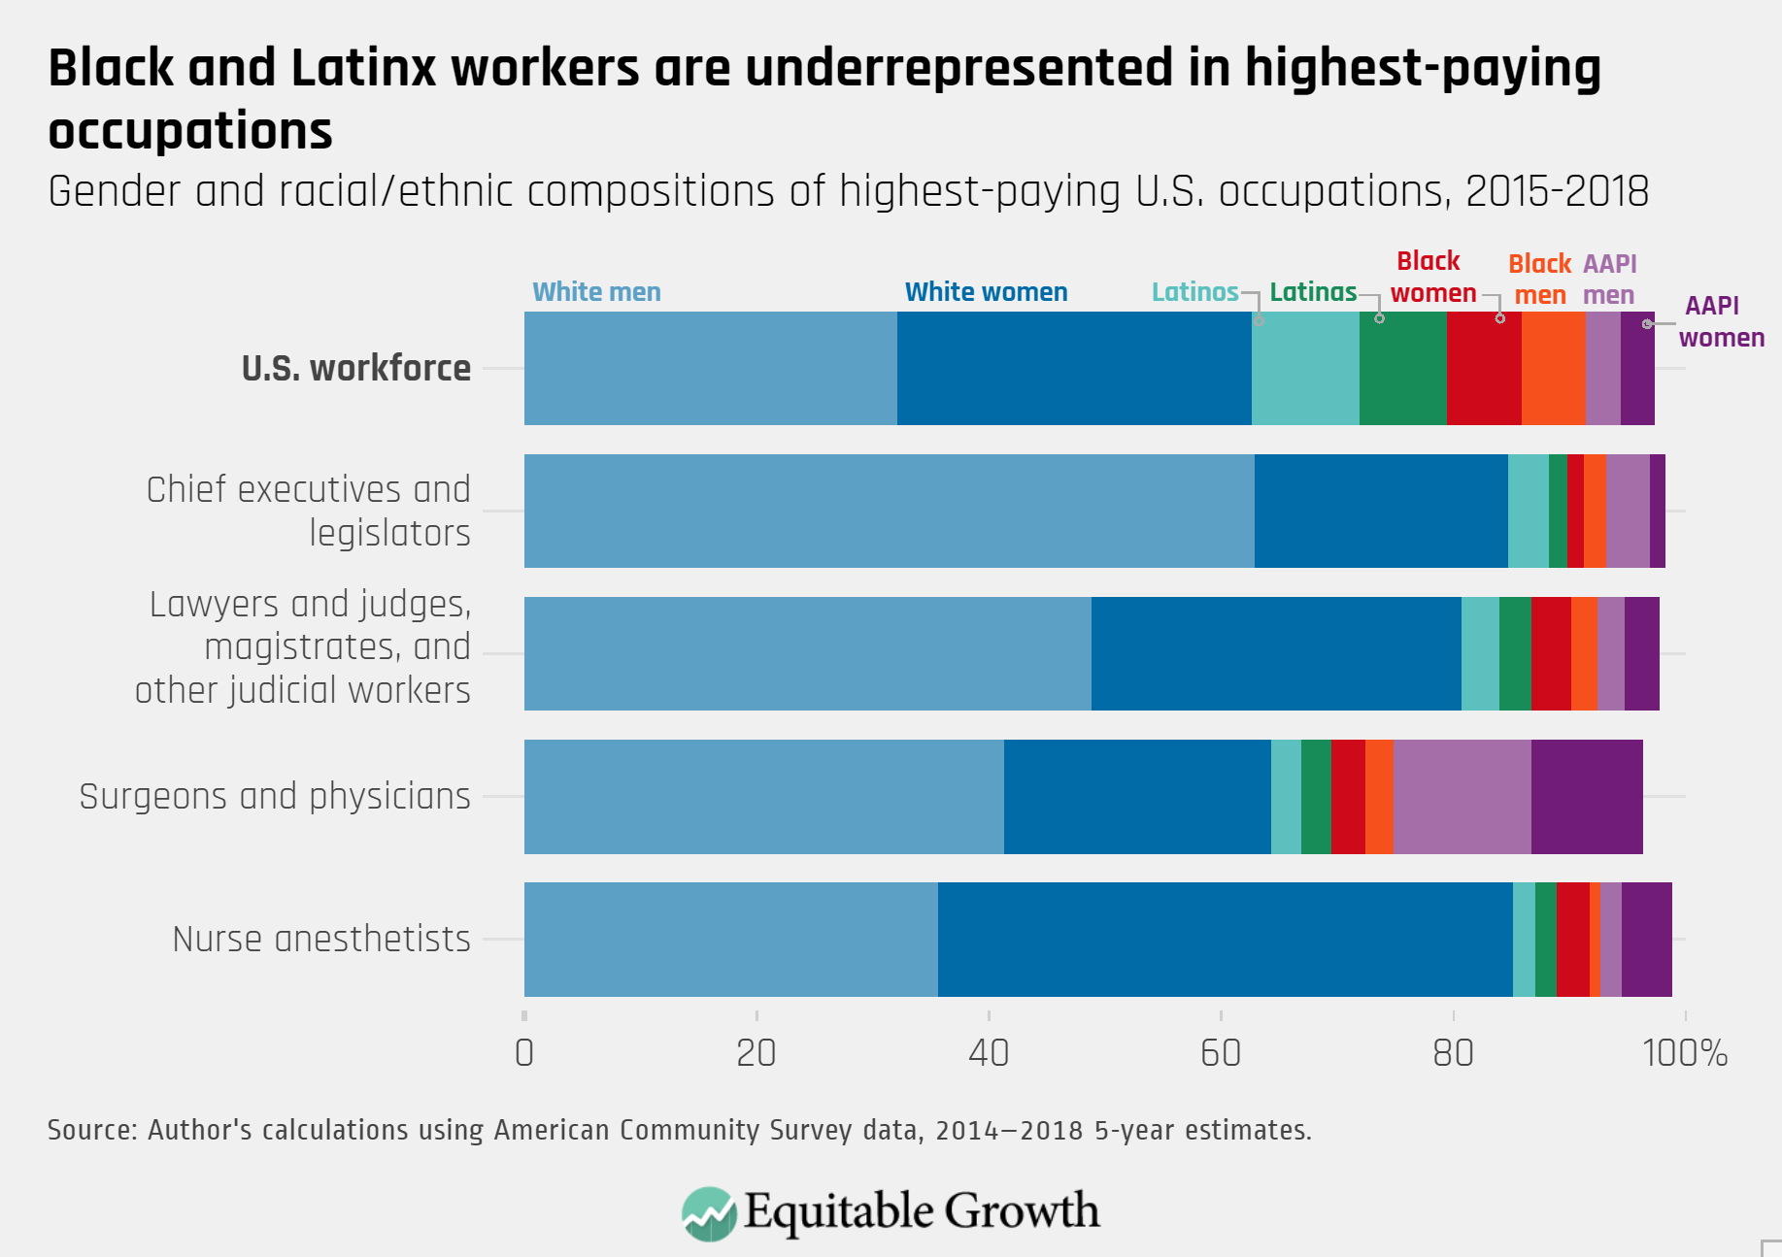

Slide 23
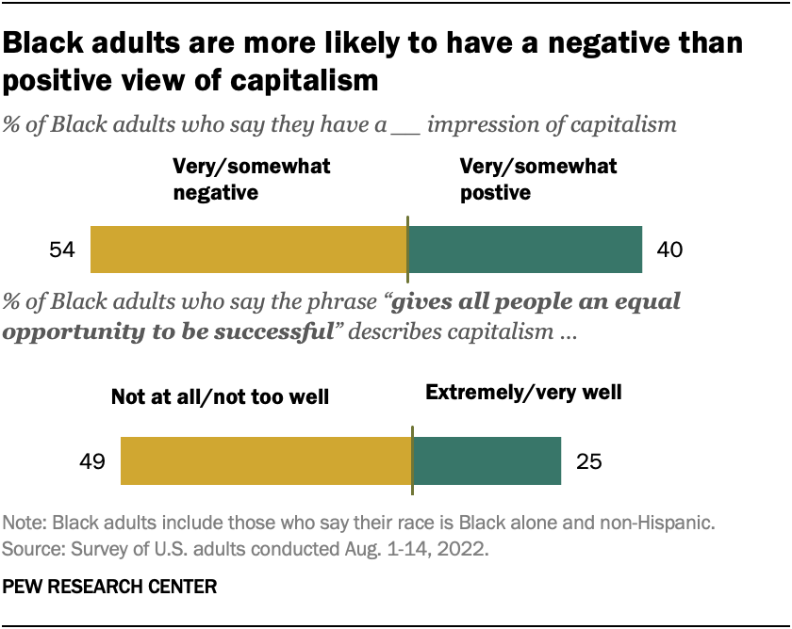
Black People don’t like capitalism!
Do Black
people
like the
system
they are
In?

Slide 24
The Black middle class
The shift in the Black middle class: business to the professions. A college education is the ticket into the middle class.

Slide 27
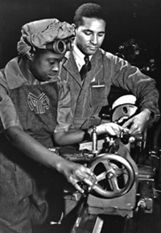
Black workers:
From production work to service work, from workers to robots

Slide 28
What is new about 21st century capitalism?
AI (Artificial Intelligence)
Digital tools
Computers
Robots
Total surveillance
Global scale
Horizontal & Vertical
integration

Slide 32
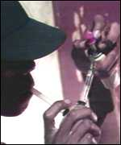
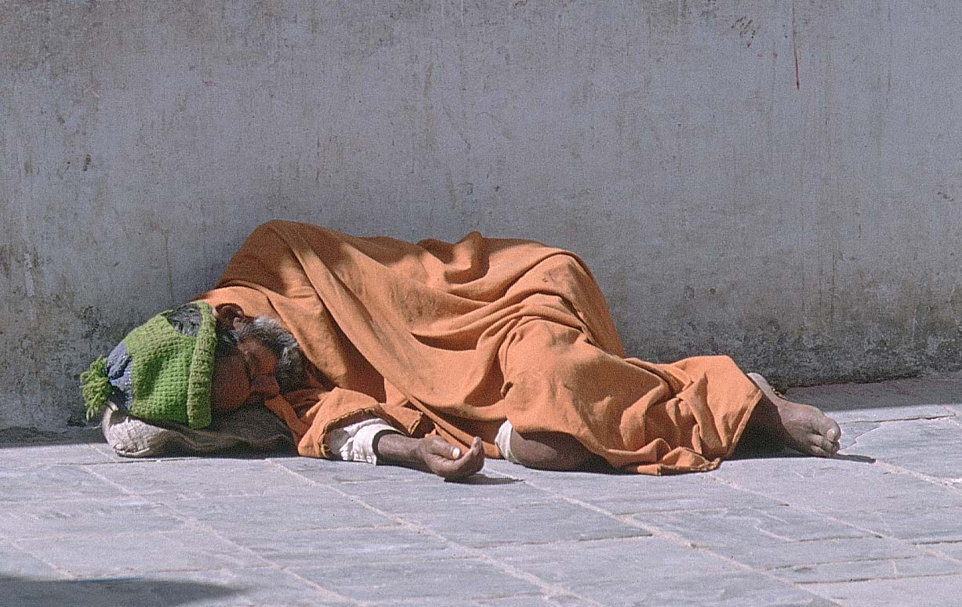
The “outsiders – the anti-class”
Almost 20% of Black people will never have a good job, and will be marginalized, criminalized, and liquidated. The system has no future for this class.

Slide 35
History of class and class struggle: Social Class and Black People 2023
The Black capitalist class: main income from ownership, especially stocks
The Black middle class: main income from professional jobs and family businesses
The Black working class: main income from jobs with little freedom of decision making
The Black anti-class: main income insecure from government and underground economy

Slide 36
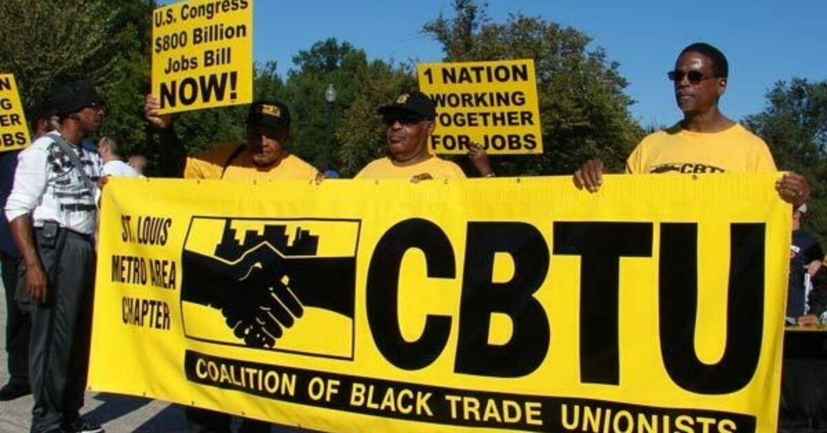
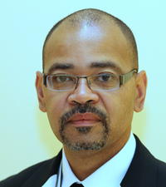

Slide 37
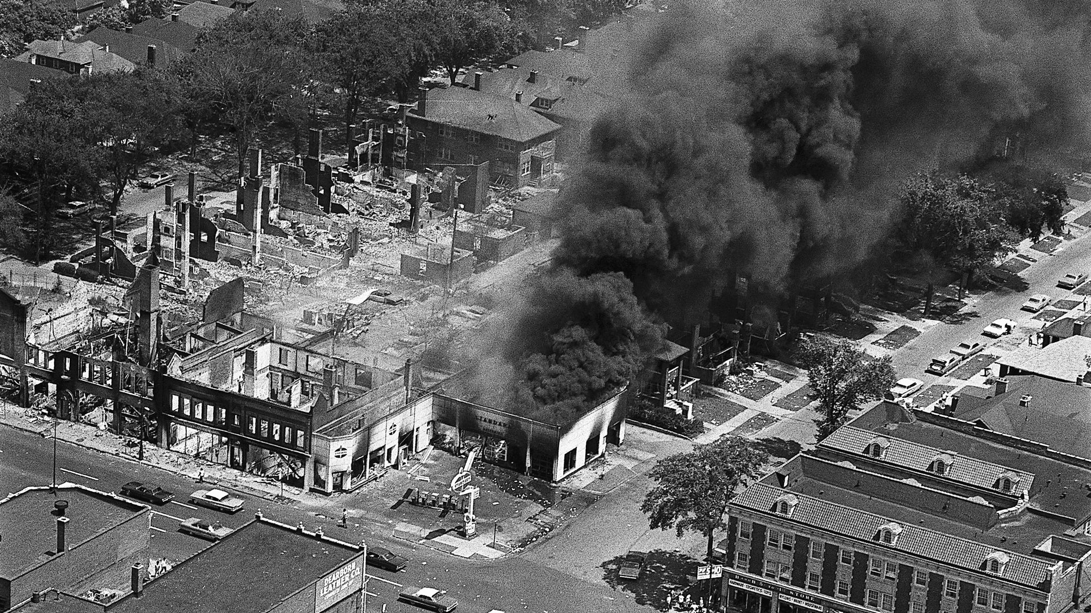
1967 Detroit Rebellion

Slide 38
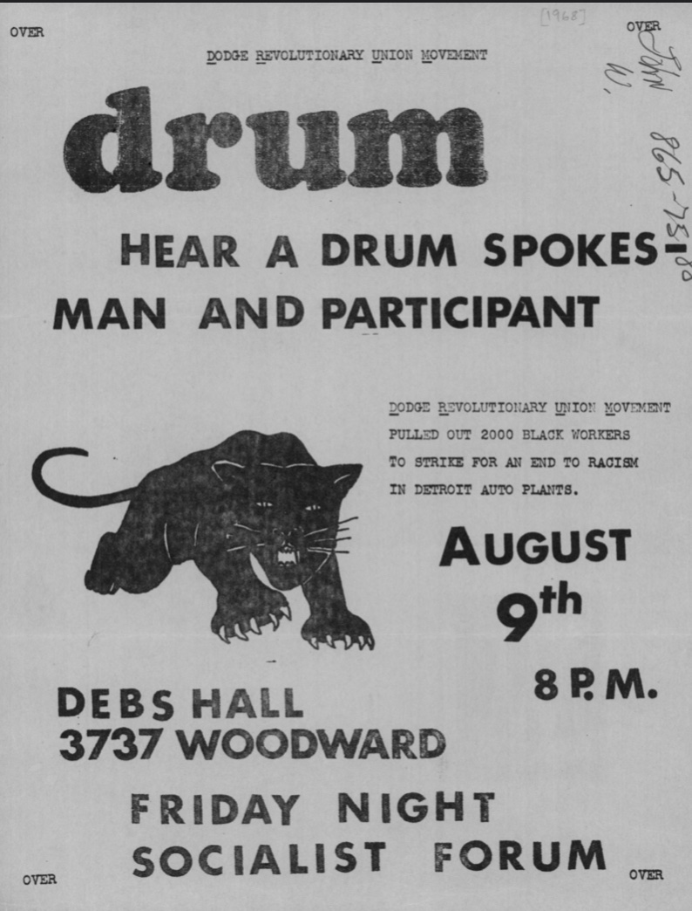
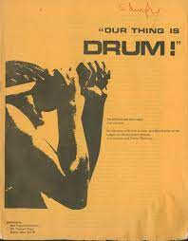
Detroit: Black workers begin to organize
1968

Slide 40
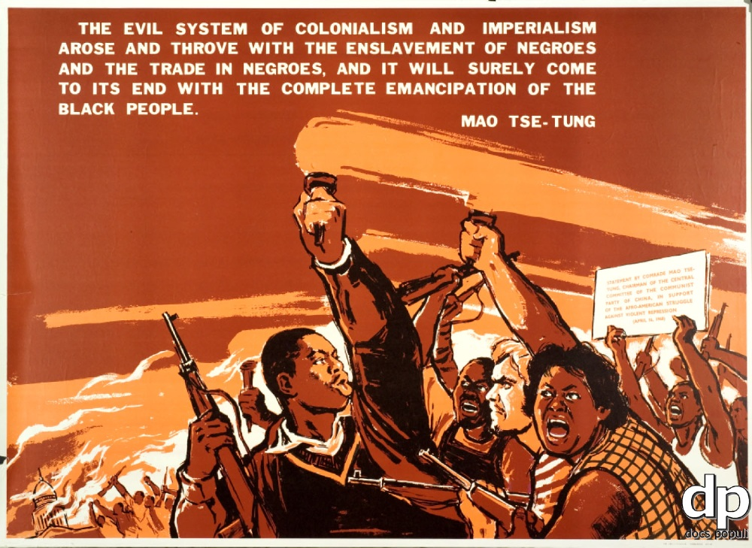

Slide 41
Black Liberation is the key to revolution
“Labor in a white skin cannot emancipate itself where it is branded in a black skin.” Karl Marx
“You show me a Capitalist, I’ll show you a bloodsucker.”
Malcolm X

Slide 42
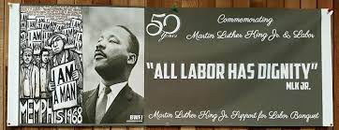
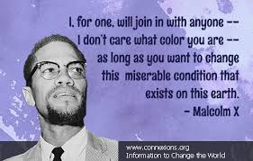
Power!

Slide 43
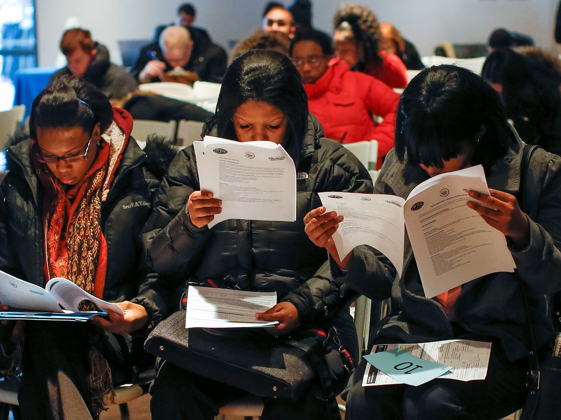
Summary
Every society is made up of a class structure
This is both by stratification and political economy
The majority of Black people are in the working class
Black liberation is a class question
Black liberation can not be realized under capitalism

