Slide 1
Color
Abdul Alkalimat
IFA: Intro for all
Community Lecture #1
August 26, 2023

Slide 2
How to participate in the discussion?
Almost 250 people have registered, and over 100 want to be in the discussion. There are several ways to do so. Out time is limited to 90 minutes, including 45 minutes of presentation.
Several people will be selected to speak for no more than 4 minutes each. Video is required.
Use the chat function on Zoom to share questions, comments, links, other sources (100 word limit)
Send all more extensive comments to mcworter@illinois.edu by Wed noon that will be compiled and posted to abdulslist on Friday
Take the discussion into your classes, your networks and all other Black Studies contexts
We look forward to our collective intelligence.

Slide 3
Color
Abdul Alkalimat
IFA: Intro for all
Community Lecture #1
August 26, 2023

Slide 4
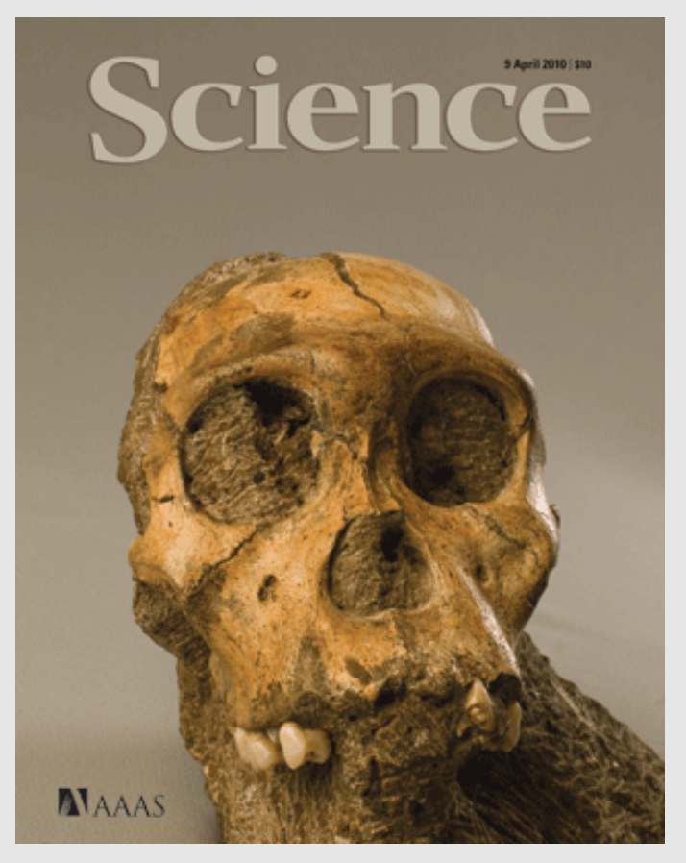
Outline
Who are humans?
Racism versus “Race”
Physiology
Archeology
Genetics
Summation
Discussion

Slide 5
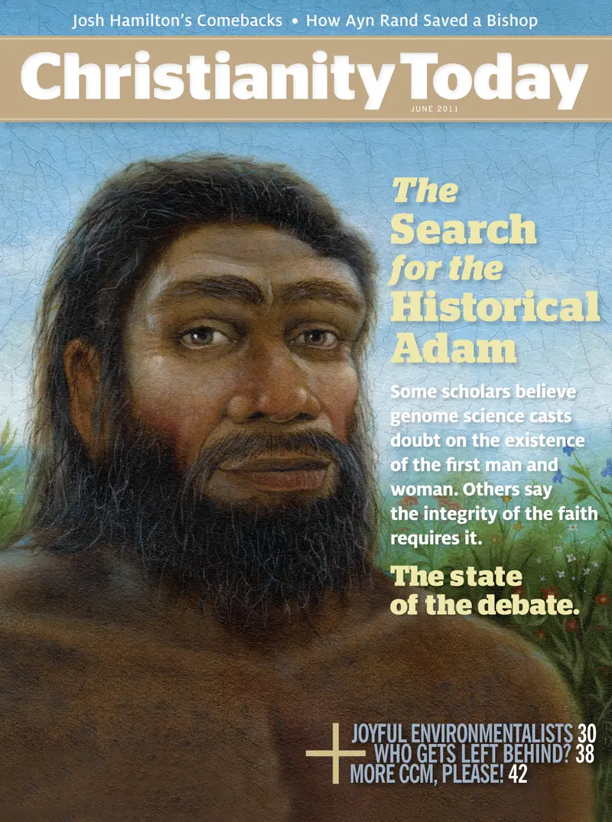
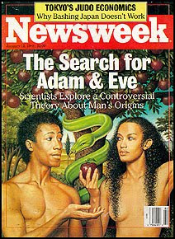
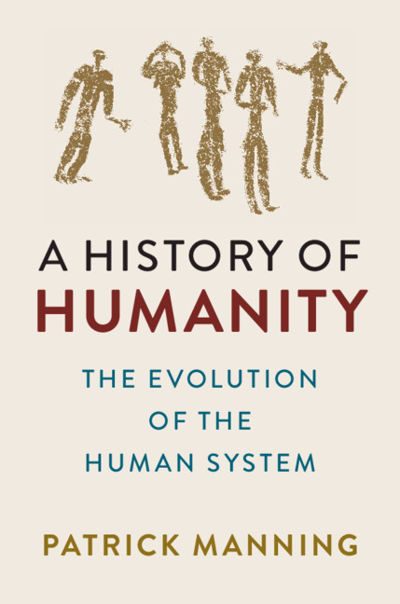
The Origin of Humanity:
Two Theories: Religion and Science
Contrasting Beliefs and Empirical Evidence

Slide 6
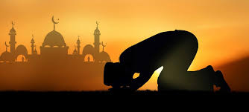
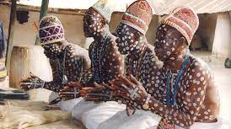
Islam
"We created man from sounding clay, from mud moulded into shape..." (15:26). "He began the creation of man from clay, and made his progeny from a quintessence of fluid" (32:7-8).
Religion
IFA of the Yoruba
Olodumare sent Obatala to earth to create man. Obatala went to earth with the materials of creation. He descended upon Ife, the wide landmass, and began to create man out of clay
Christianity
"The Lord God formed man of the dust of the ground, and breathed into his nostrils the breath of life; and man became a living soul.“
Genesis 2/7

Slide 7
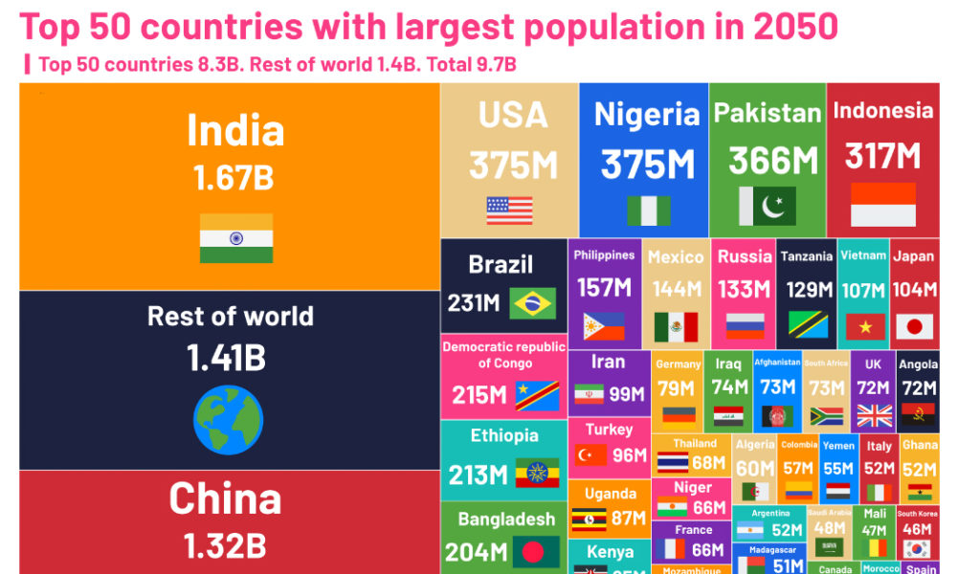

Slide 9
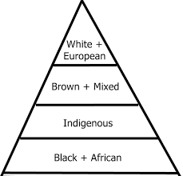
Racism versus “Race”

Slide 10
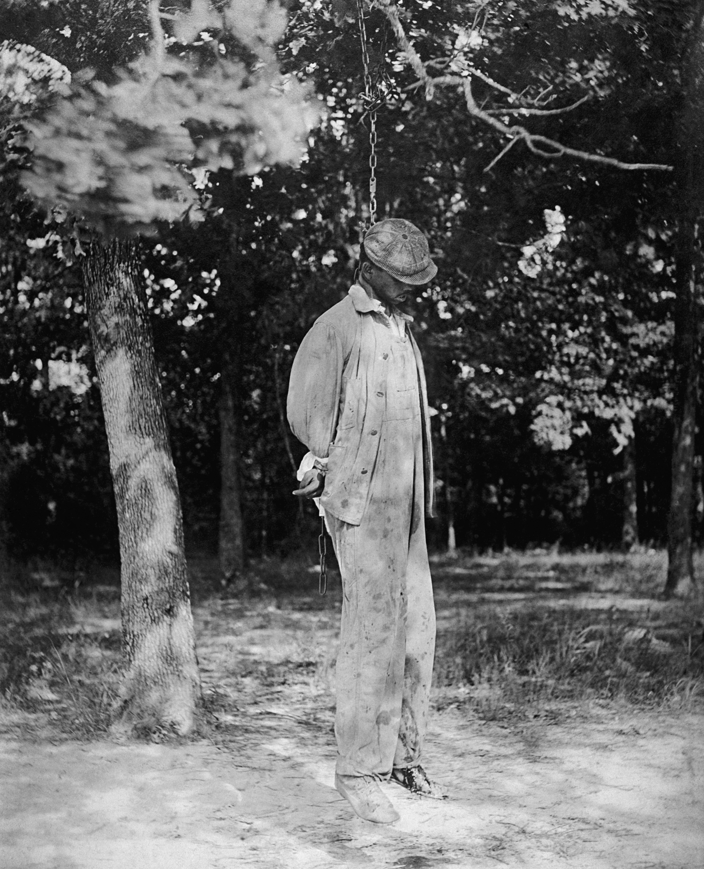
Racism
1) A universal classification of groups as being in exclusive and discrete…
2) Ranking of these groups vis-à-vis one another…
3) Outer physical characteristics are surface manifestations of inner realities;
4) The notion that all of these qualities were inheritable…
5) The belief that each exclusive group was created unique and distinct by nature or by God.
Audrey Smedley, Race in North America: Origin and Evolution of a Worldview

Slide 11
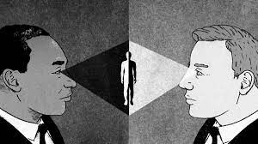
Racism is what one believes, sees, and acts upon
Prejudice
Discrimination
Segregation
Redlining Gerrymandering
Quotas
Profiling
The key issue is who has power!

Slide 12
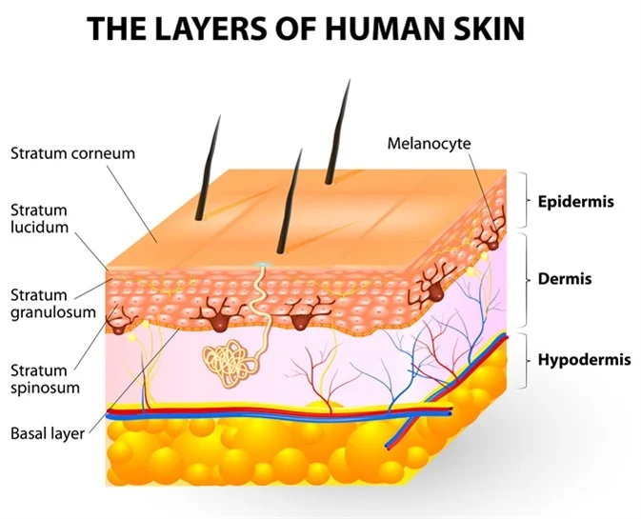
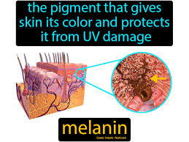
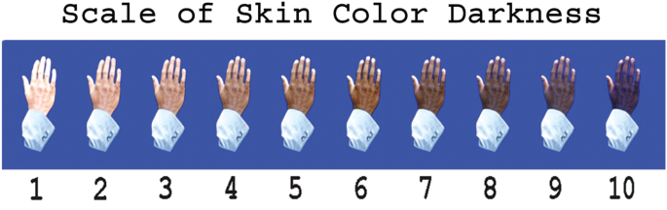

Slide 13
Racism has a legal history in the US!
In 1911, Arkansas passed Act 320 (House Bill 79), also known as the “one-drop rule.” This law had two goals: it made interracial “cohabitation” a felony, and it defined as “Negro” anyone “who has…any negro blood whatever,” thus relegating to second-class citizenship anyone accused of having any African ancestry. Although the law had features unique to Arkansas, it largely reflected nationwide trends.

Slide 14
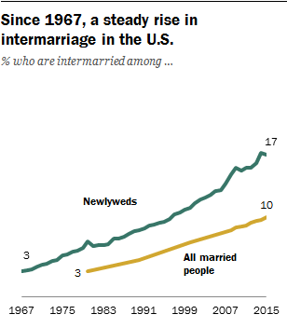
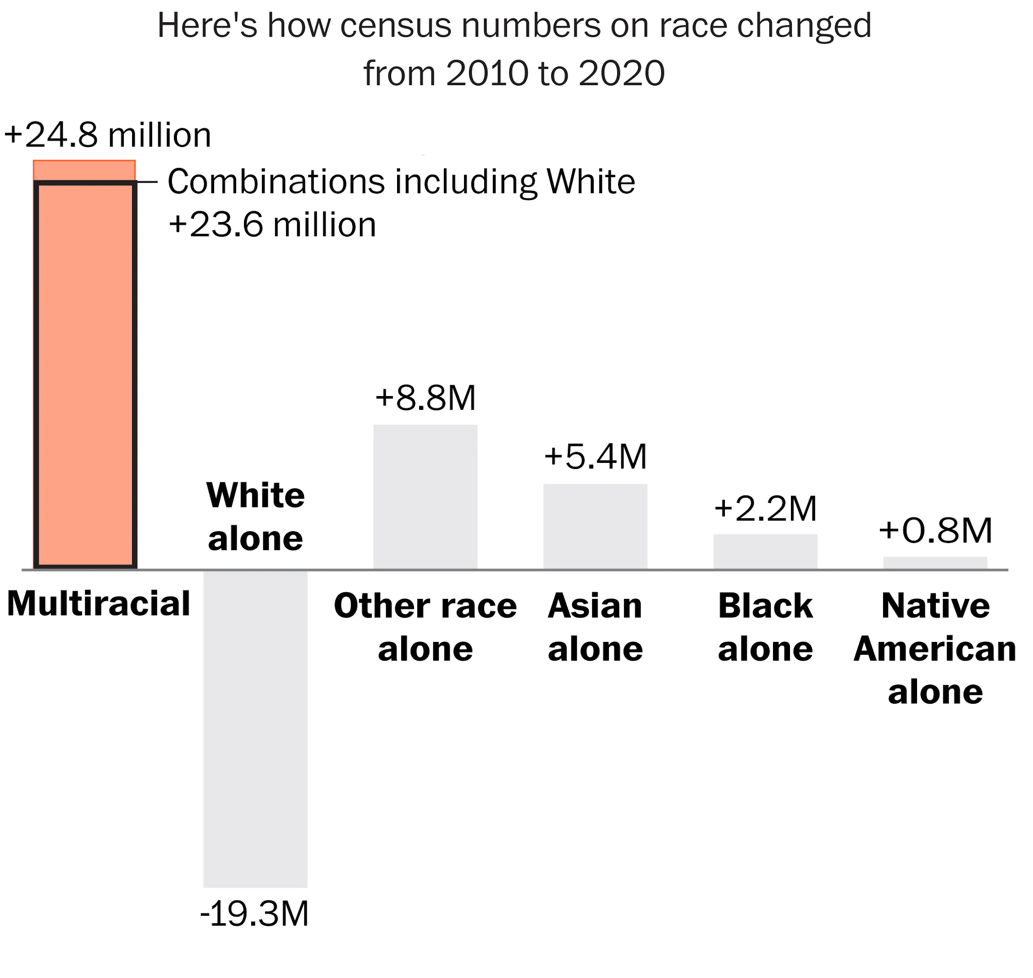
What color is the US becoming?

Slide 15
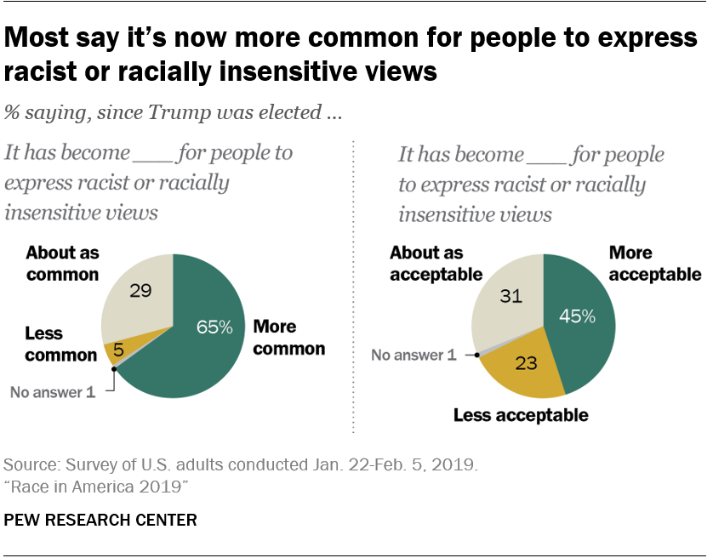

Slide 16
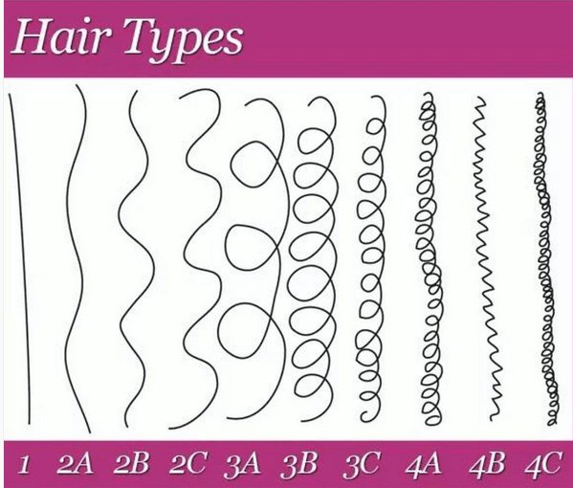
Racism creates self-hate
Racism created a distinction between good hair and bad hair
Have we achieved Black hair liberation?

Slide 17
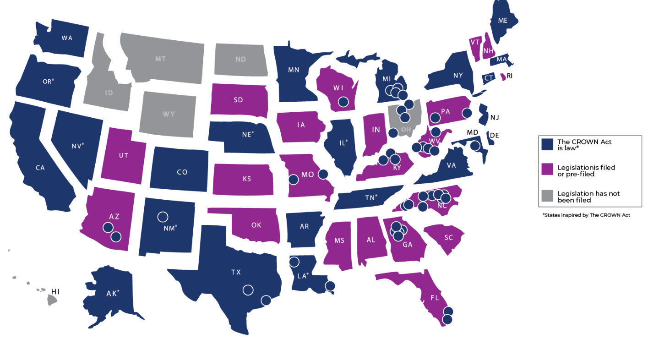
Imani Jackson spent 45 minutes every day putting a cap over her naturally curly hair and gluing a wig with straight hair in its place, according to federal court documents. One day, she stopped. Instead of the wig, Jackson — who is Black — began wearing her natural hair in a “neat bun,” attorneys said. Within a month, she was fired.
July, 2023 Louisiana
The Crown Act legislation demands protection against race-based hair discrimination in the workplace and in K-12 public and charter schools based on hair texture and protected styles. As of 2023, the Crown Act has been enacted in 22 states.

Slide 18
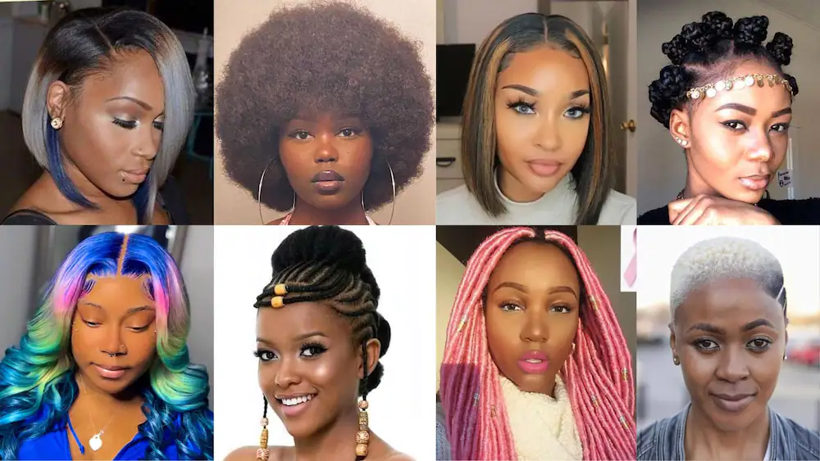

Slide 19
Historical research has shown that the idea of "race" has always carried more meanings than mere physical differences; indeed, physical variations in the human species have no meaning except the social ones that humans put on them. Today scholars in many fields argue that "race" as it is understood in the United States of America was a social mechanism invented during the 18th century to refer to those populations brought together in colonial America: the English and other European settlers, the conquered Indian peoples, and those peoples of Africa brought in to provide slave labor.
American Anthropological Association 1998
Race is a socially constructed lie!!

Slide 20
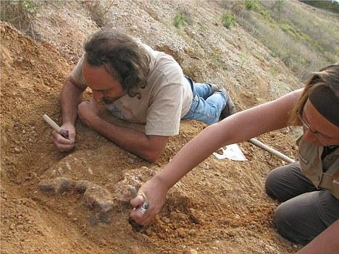
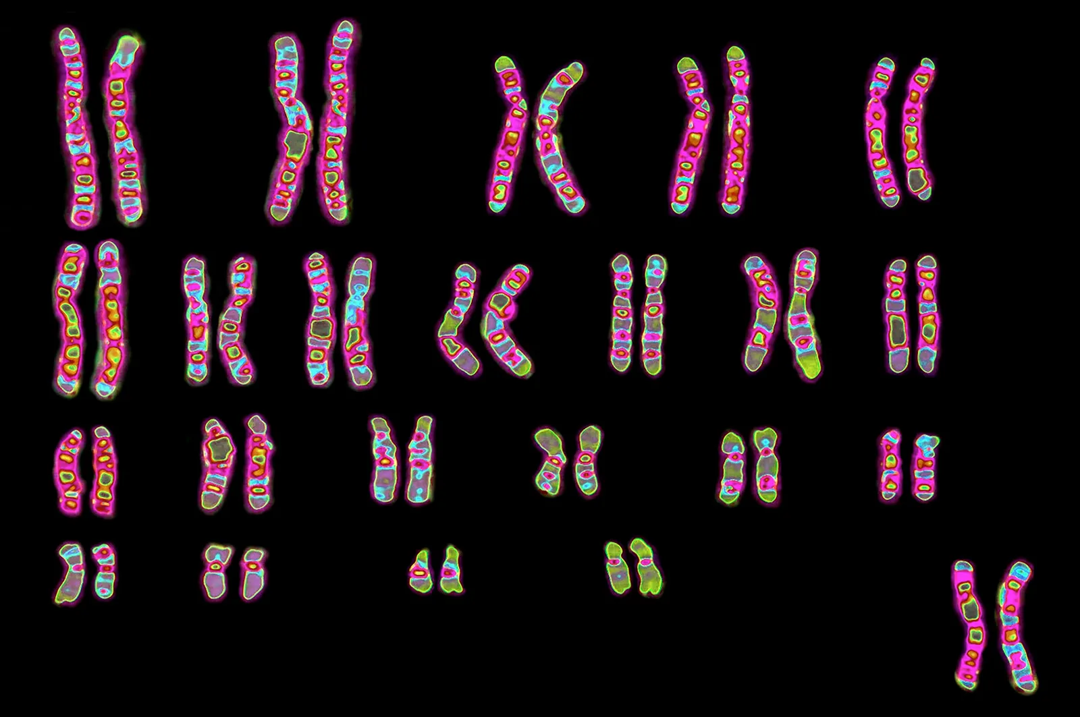
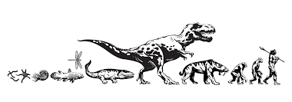
How do we know the “race” concept is a lie?
Sources of scientific knowledge
Archeology
Genetics
Anthropology
Evolutionary biology

Slide 21
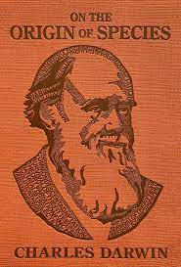
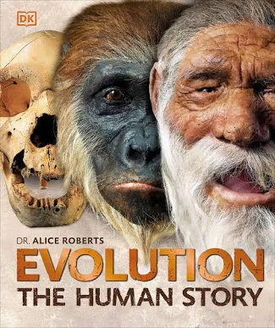
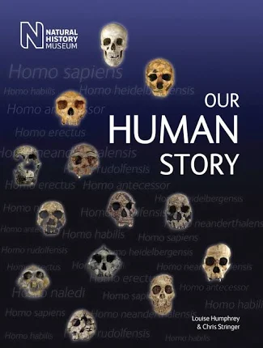
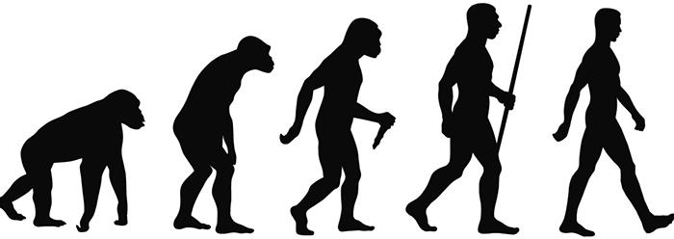
Humans developed
through evolution
We study the evolution of the human species

Slide 22
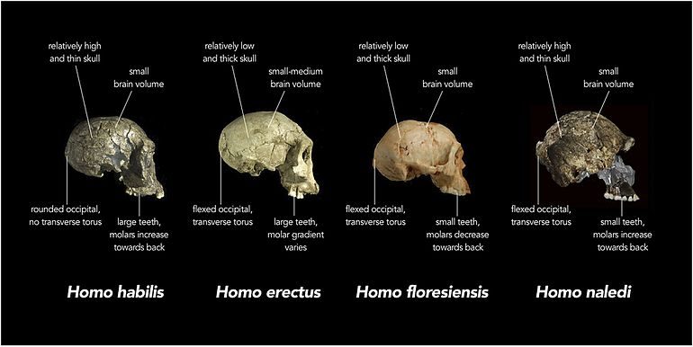
February 4, 2023
“In 2015, a new species of early human, named Homo naledi, was discovered in the Rising Star Cave in South Africa. This discovery, led by paleoanthropologist Lee Berger, is significant because it suggests that Homo naledi lived alongside other early human species, such as Homo erectus and Homo habilis, and may have coexisted with our own species, Homo sapiens, for tens of thousands of years.”

Slide 23
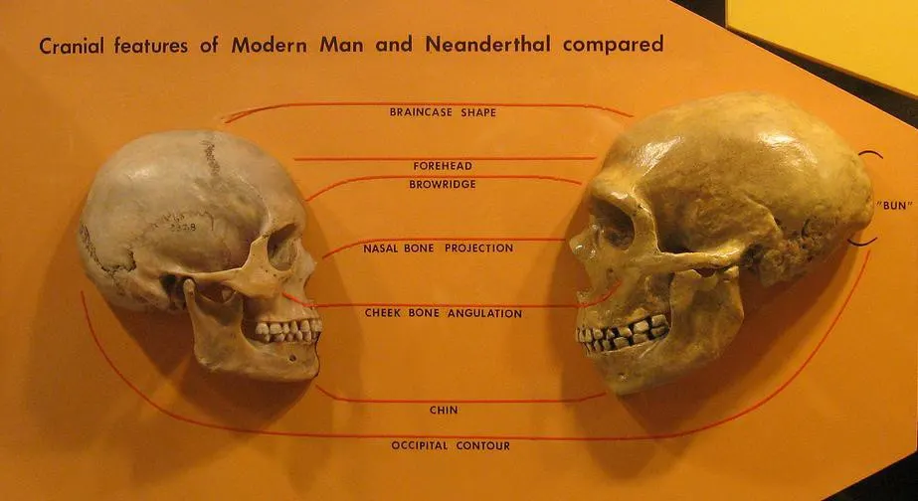

Slide 24
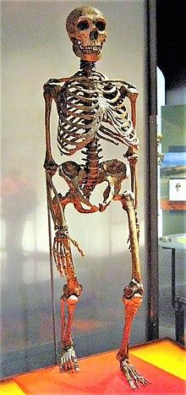
Both fossil and genetic evidence indicate that Neanderthals and modern humans (Homo sapiens) evolved from a common ancestor between 700,000 and 300,000 years ago. Neanderthals and modern humans belong to the same genus (Homo) and inhabited the same geographic areas in western Asia for 30,000–50,000 years; genetic evidence indicate while they interbred with non-African modern humans, they ultimately became distinct branches of the human family tree (separate species). Smithsonian

Slide 26
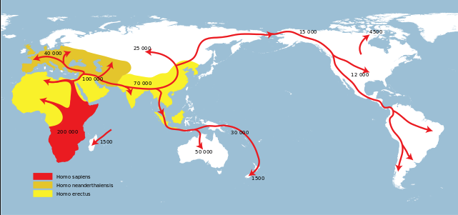
There is one human species. The origin is Africa!

Slide 27
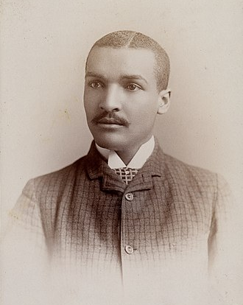
We need Black scientists!
The Society of Black Archaeologists was created in 2011 with five goals in mind: To lobby on behalf and ensure the proper treatment of African and African Diaspora material culture. To encourage more people of African descent to enter the field of archaeology; To raise and address concerns related to African peoples worldwide; To highlight the past and present achievements and contributions that people of African descent have made to the field of archaeology; To ensure the communities affected by archaeological work act not just as objects of study or informants but are active makers and/or participants in the unearthing of their own history
John Wesley Gilbert (1863^{[1]} – 1923),
the first Afro-American archaeologist

Slide 28
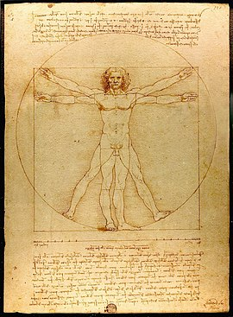
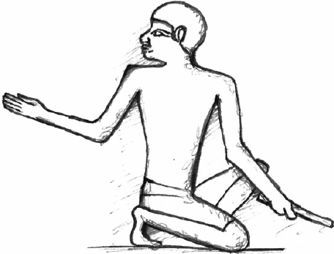
First art, then science

Slide 29
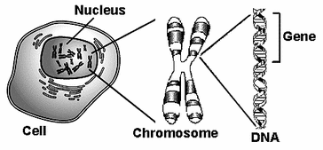
DNA is the building blocks of genes that contain the coded instruction for building and maintaining a body.
Genes are a portion of DNA that are tasked with making specific proteins that play a critical role in the structure and function of the body.
Chromosomes are structures containing many genes each.

Slide 30
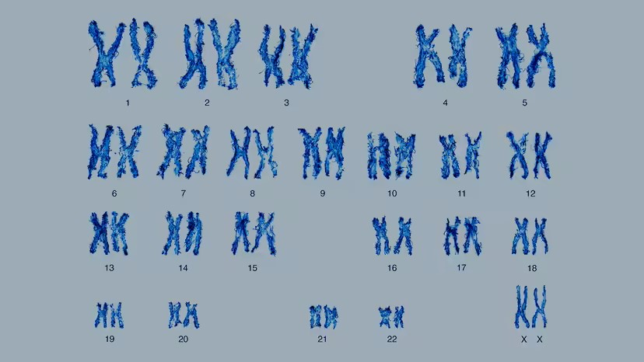
Humans have 22 pairs of numbered chromosomes (autosomes) and one pair of sex chromosomes (XX or XY), for a total of 46. Each pair contains two chromosomes, one coming from each parent, which means that children inherit half of their chromosomes from their mother and half from their father.

Slide 31
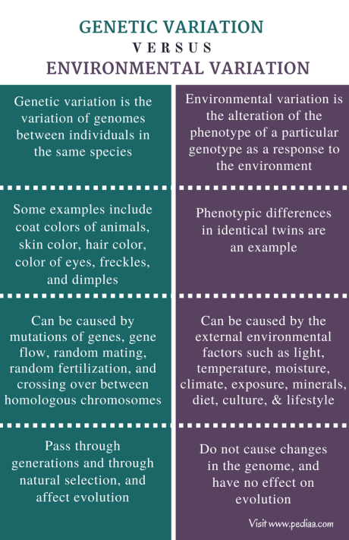
Human evolution is dynamic and
constantly changing on a global level

Slide 32
All human beings are 99.9 percent identical in their genetic makeup

Slide 33
We need Black scientists!
1905-1962
Black In Genetics, Inc. (BIG) is an organization dedicated to amplifying the voices and work of Black-identifying geneticists across the U.S. and beyond. Some of our goals include connecting Black-identifying geneticists and trainees with organizations seeking to hire them, providing the scientific community with resources on understanding racial inequity in the Genetics field, educating the public on recent advancements in Genetics, and providing a platform to host conversations about dismantling systemic racism

Slide 34
Summary
There are no races, only one human species
There are people who believe in racism
Racism is white supremacy
All physical features are superficial
Humans first evolved in Africa
All human populations are equal

